Slide 1
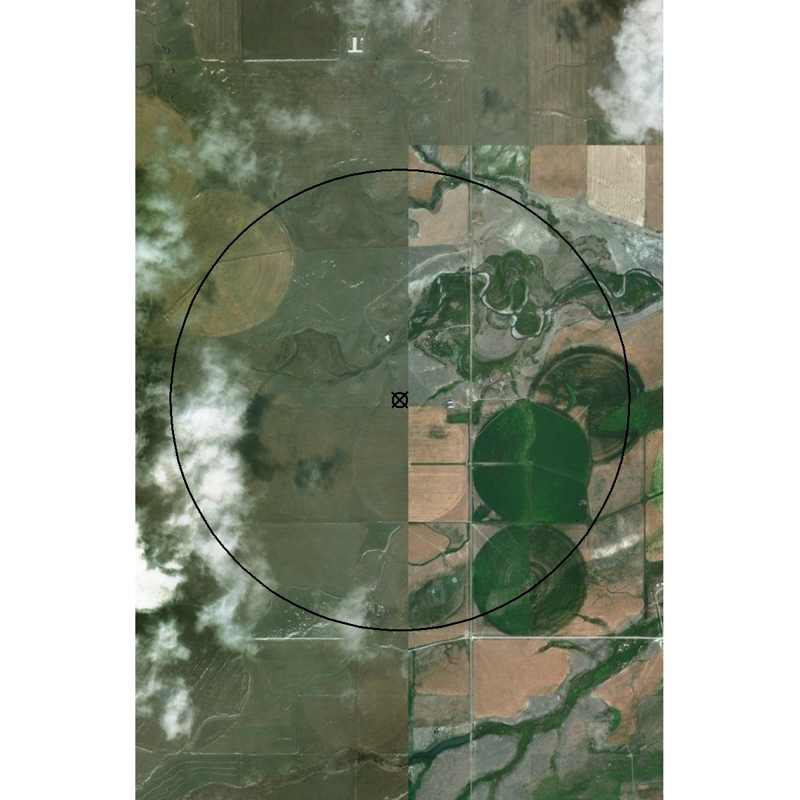
GP Agrimet Sites
BFAM – Blackfeet - Seville Colony, MT

Slide 2
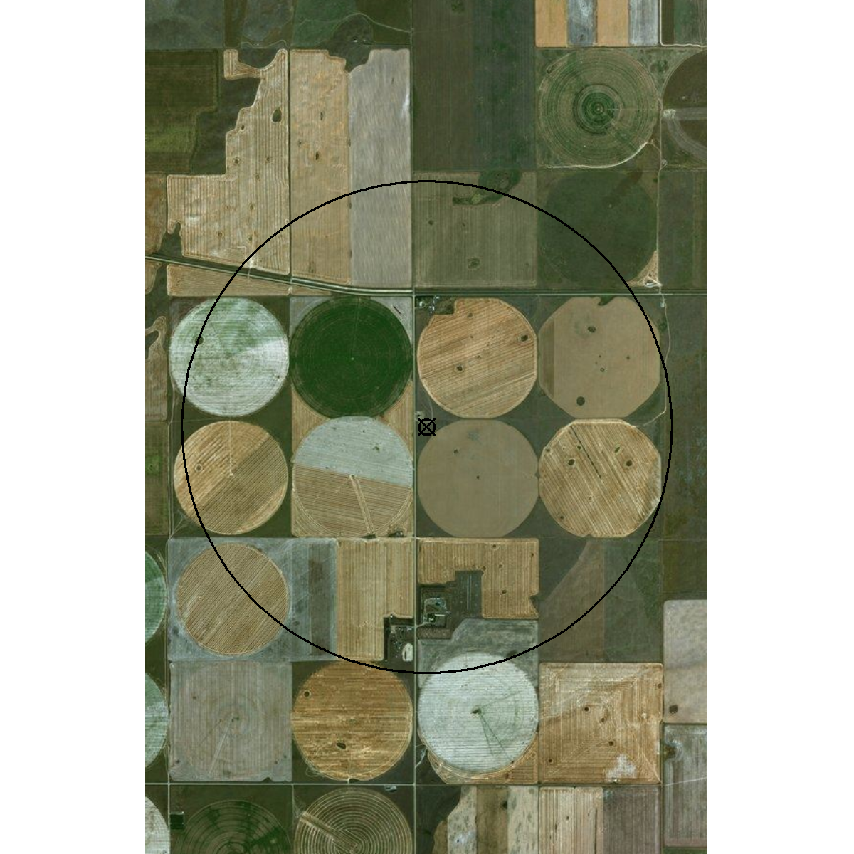
GP Agrimet Sites
BFTM – Big Flat - Turner, MT

Slide 3
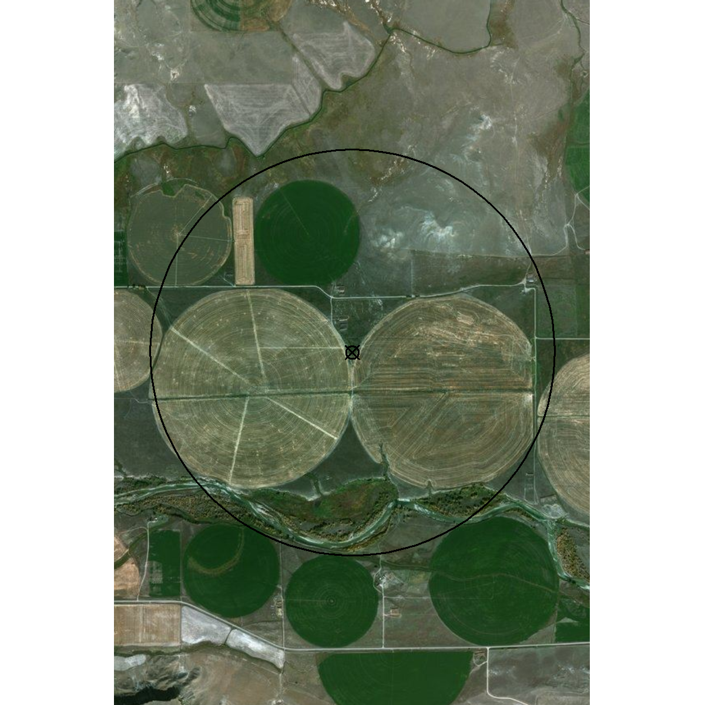
GP Agrimet Sites
BOMT – Broken-O Ranch, MT

Slide 4
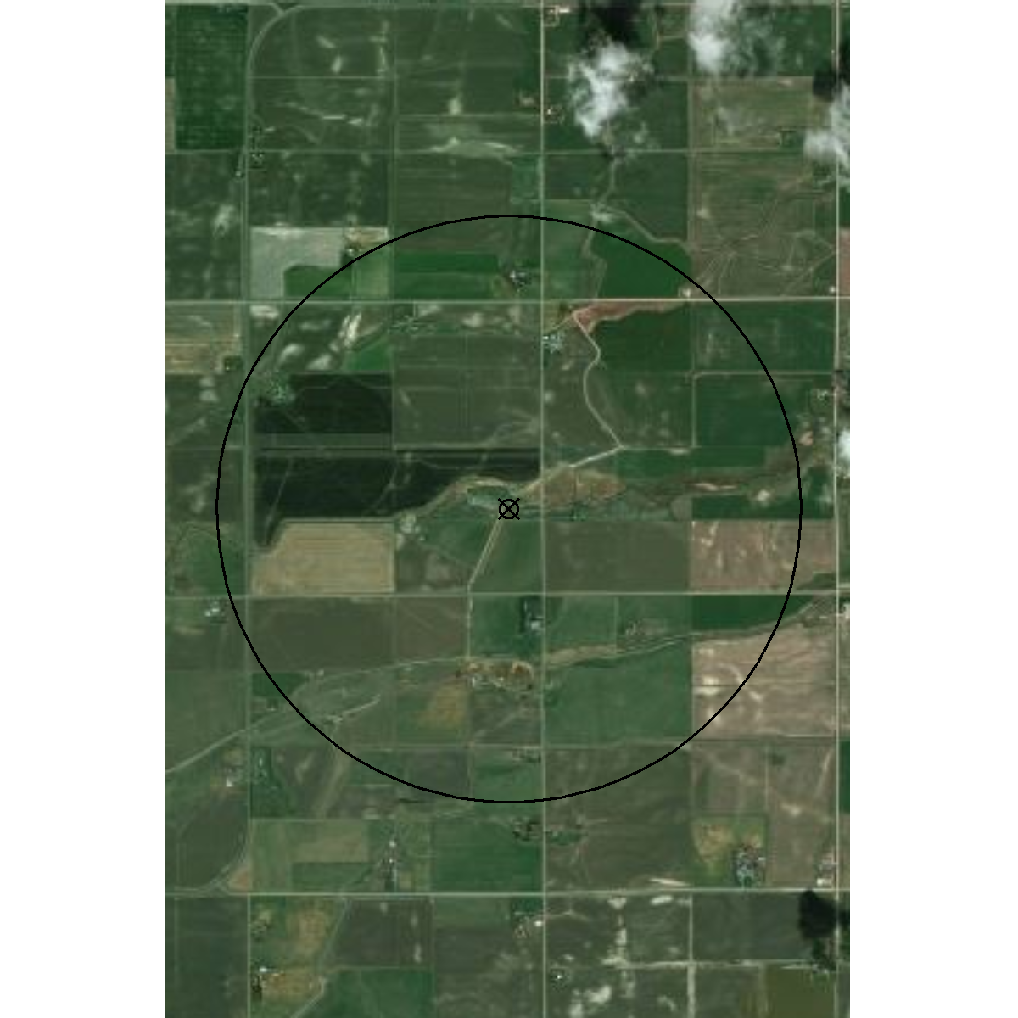
GP Agrimet Sites
GFMT – Greenfields-Fairfield, MT

Slide 5
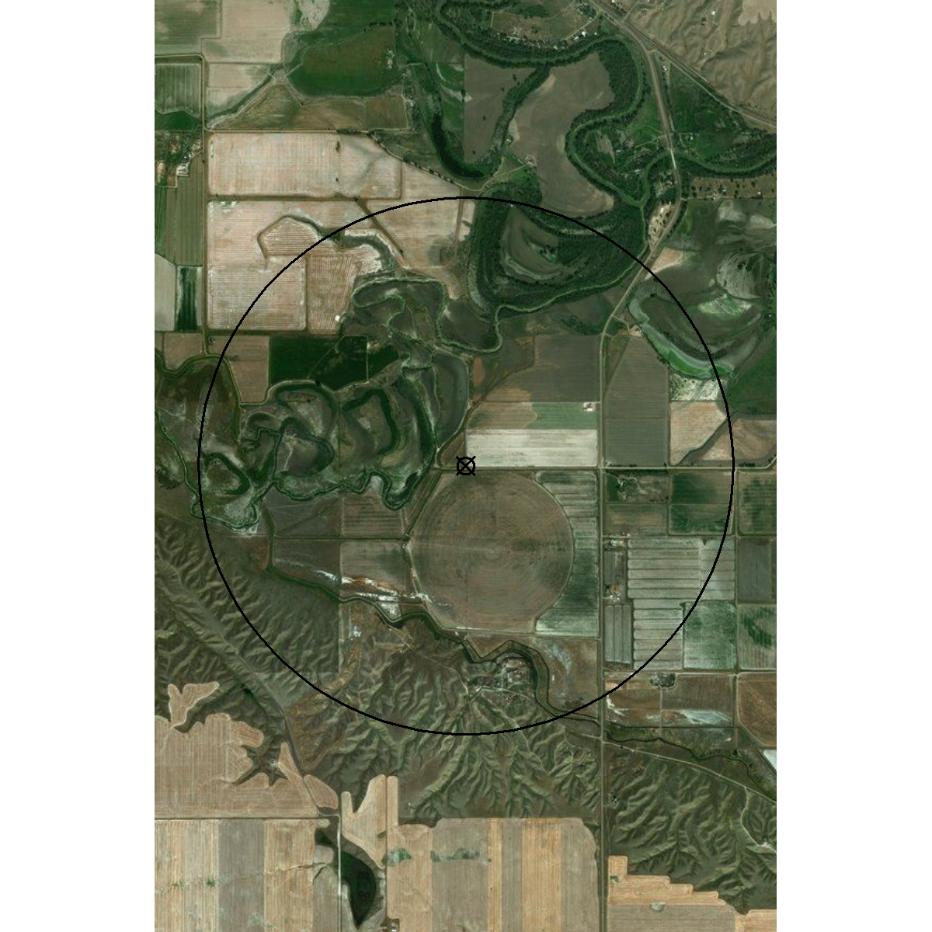
GP Agrimet Sites
GLGM – Glasgow, MT

Slide 6
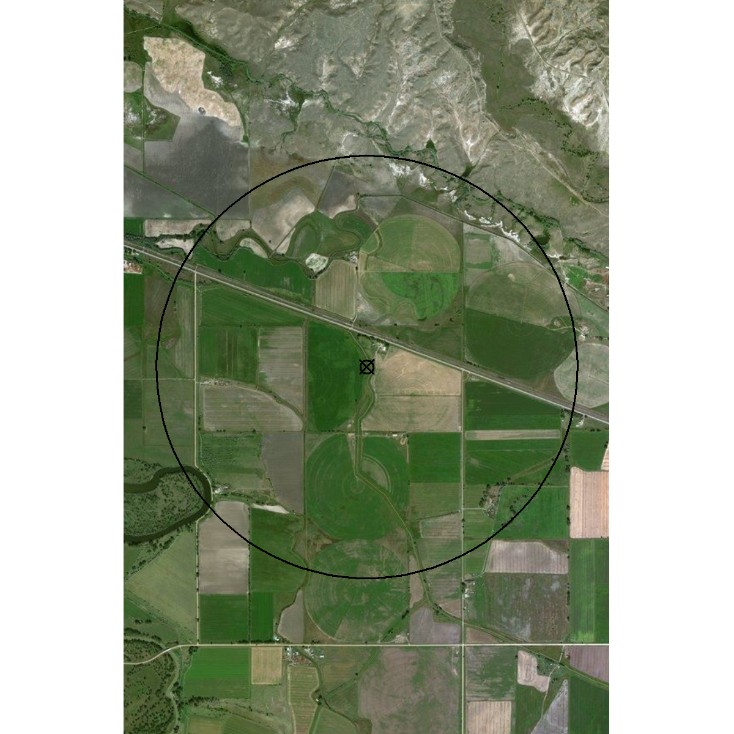
GP Agrimet Sites
HRLM – Harlem, MT

Slide 7
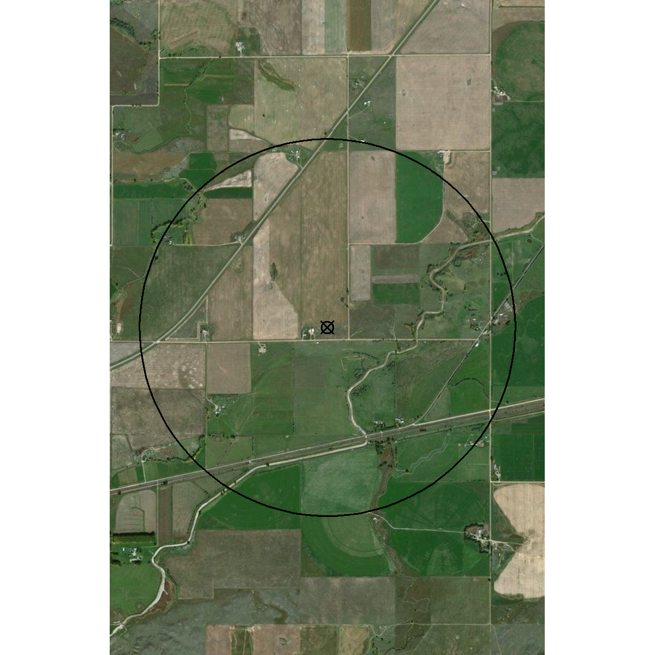
GP Agrimet Sites
MATM – Malta, MT

Slide 8
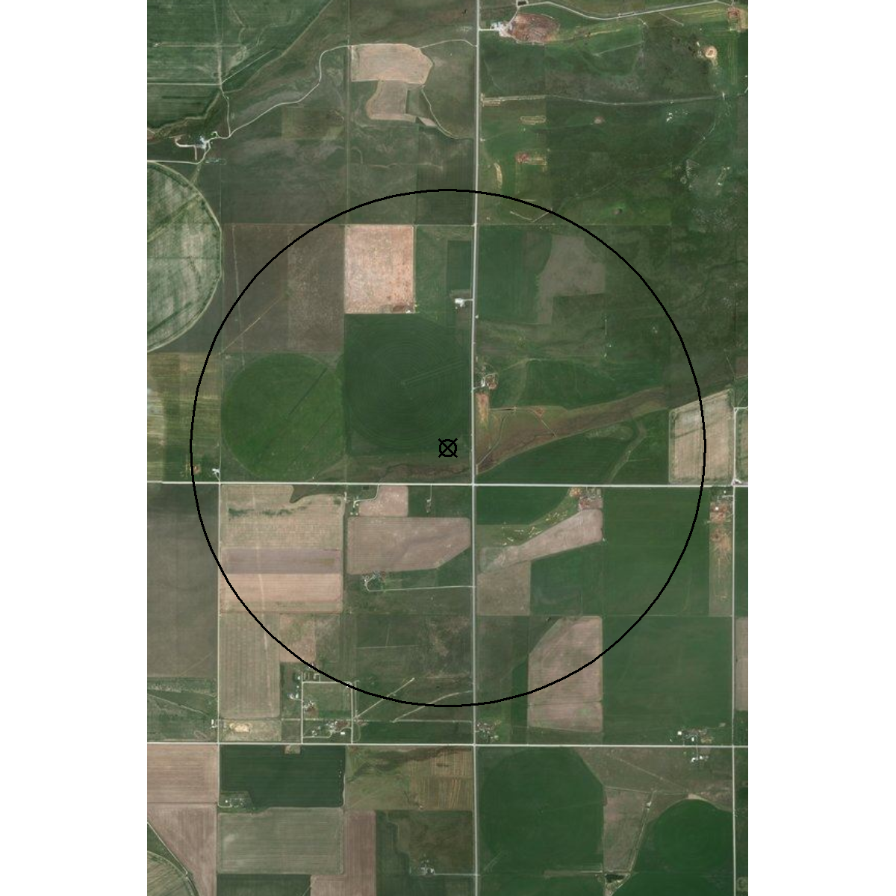
GP Agrimet Sites
TRFM – Teton River-Farmington, MT

Slide 9
MesoWest Sites (Good)

Slide 10
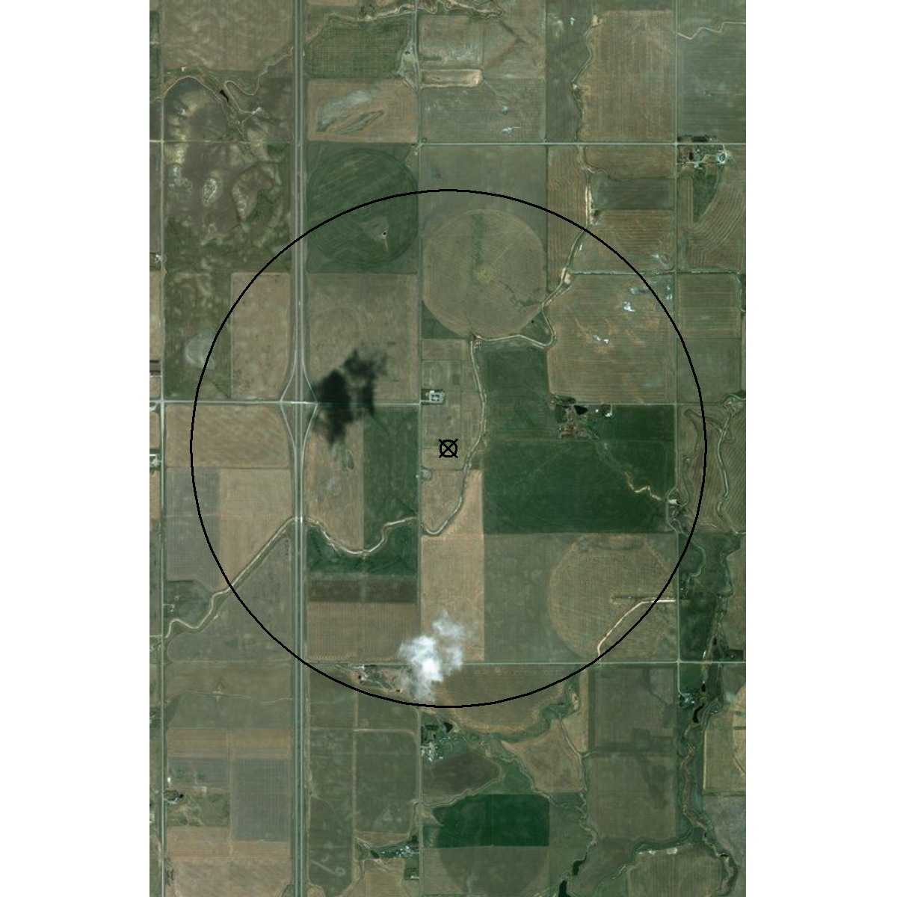
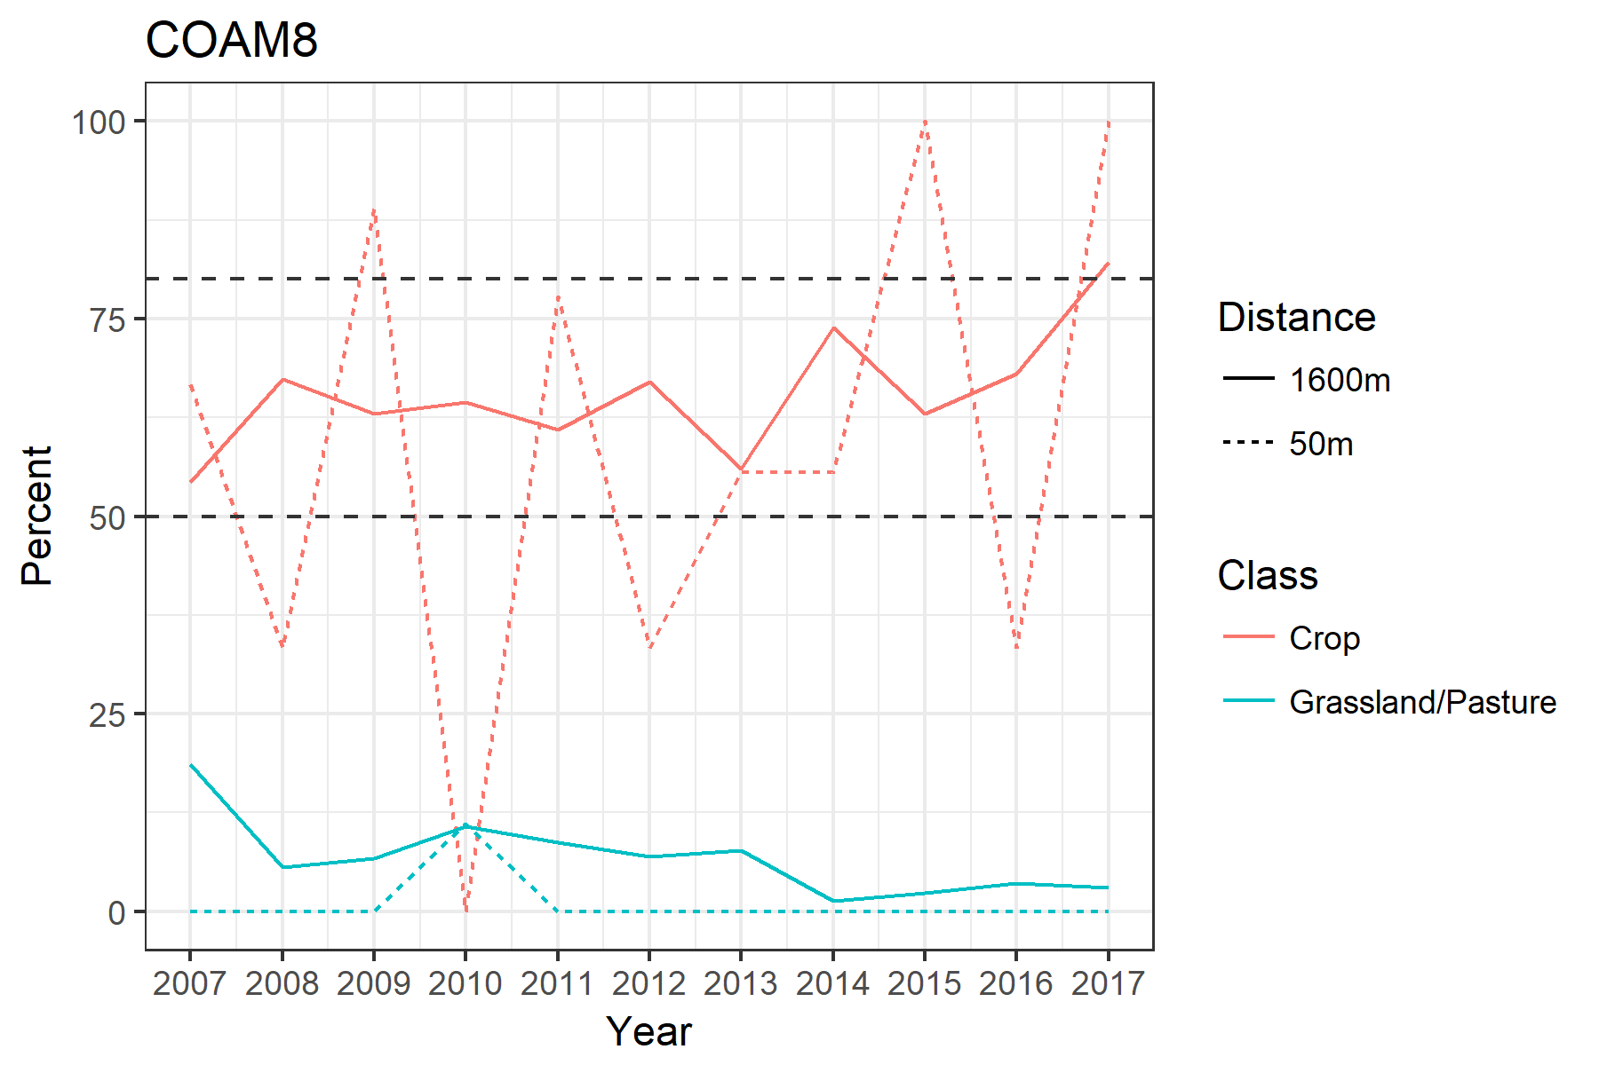
MesoWest Sites
COAM8 –

Slide 11
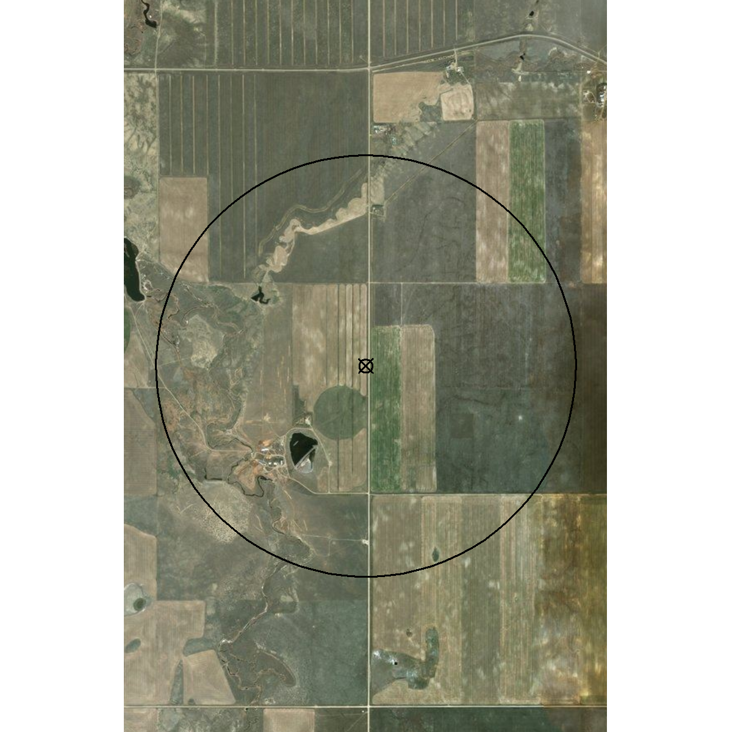
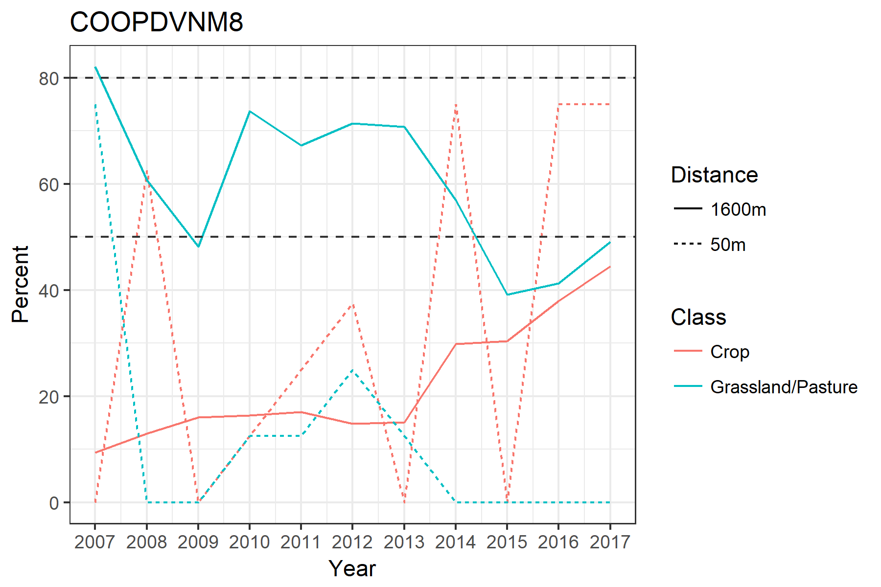
MesoWest Sites
COOPDVNM8 –

Slide 12
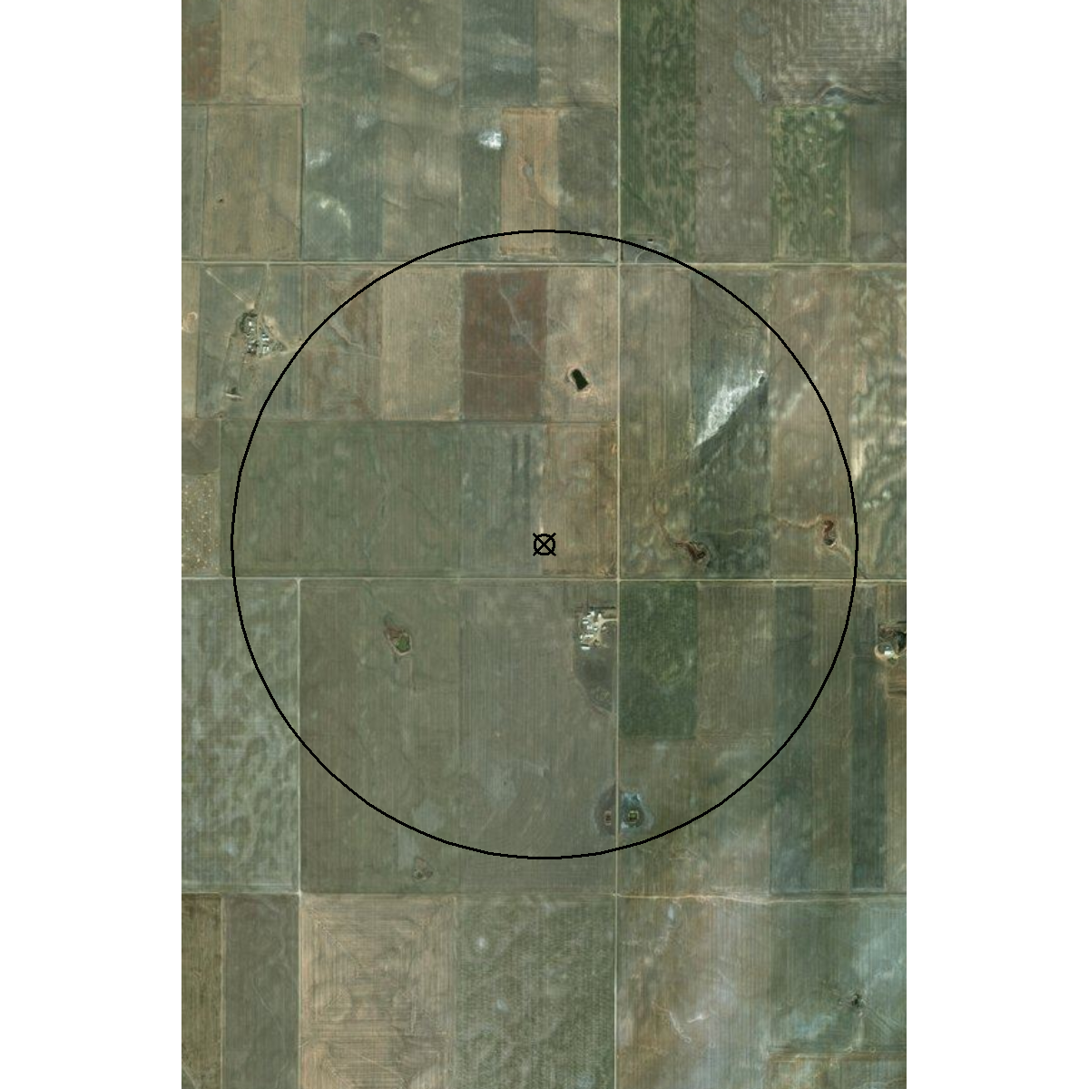
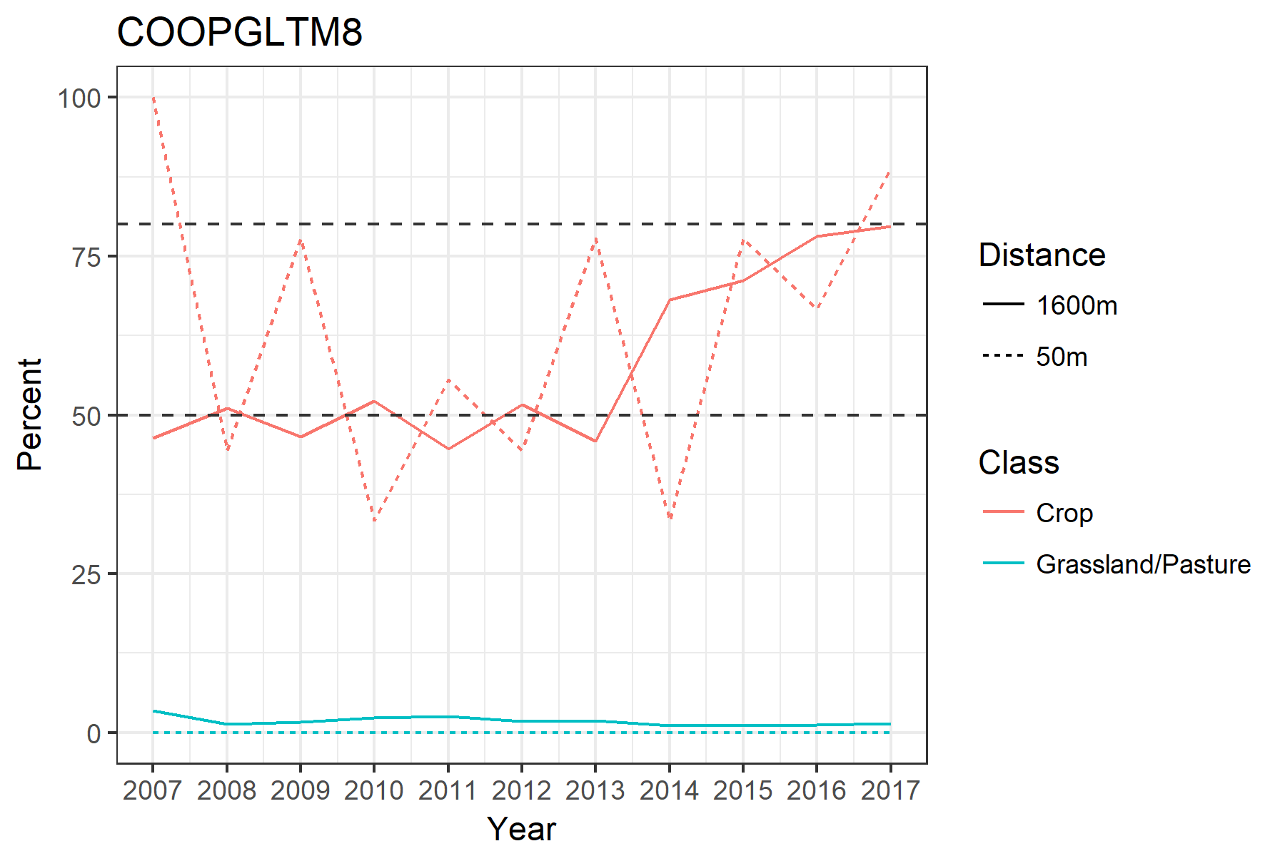
MesoWest Sites
COOPGLTM8 –

Slide 13
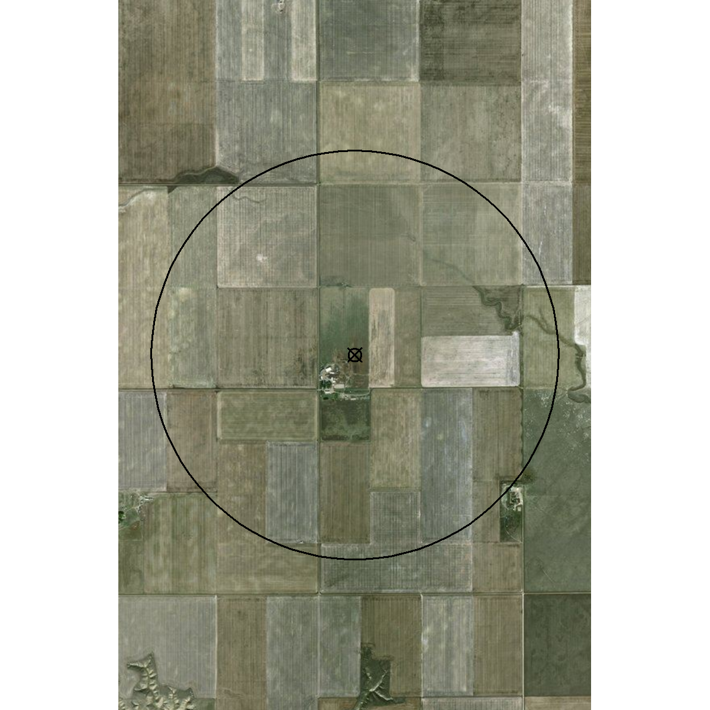
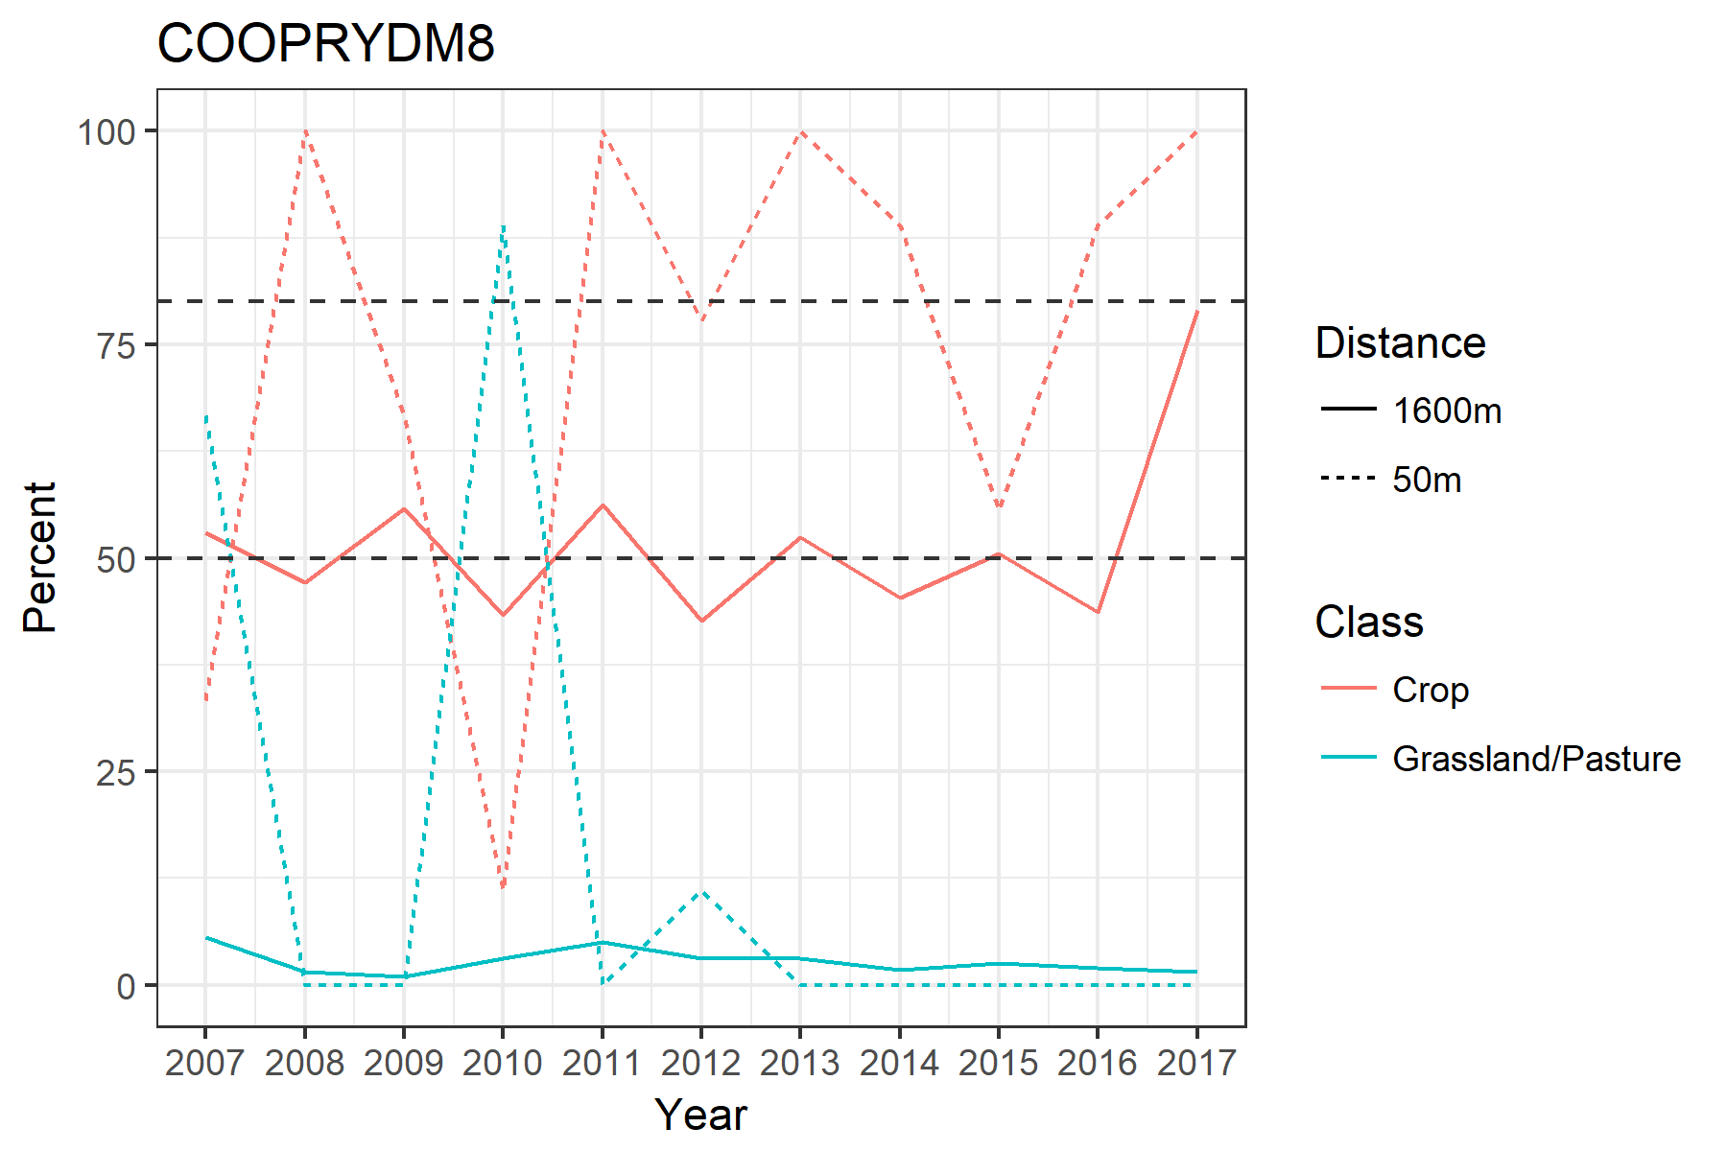
MesoWest Sites
COOPRYDM8 –

Slide 14
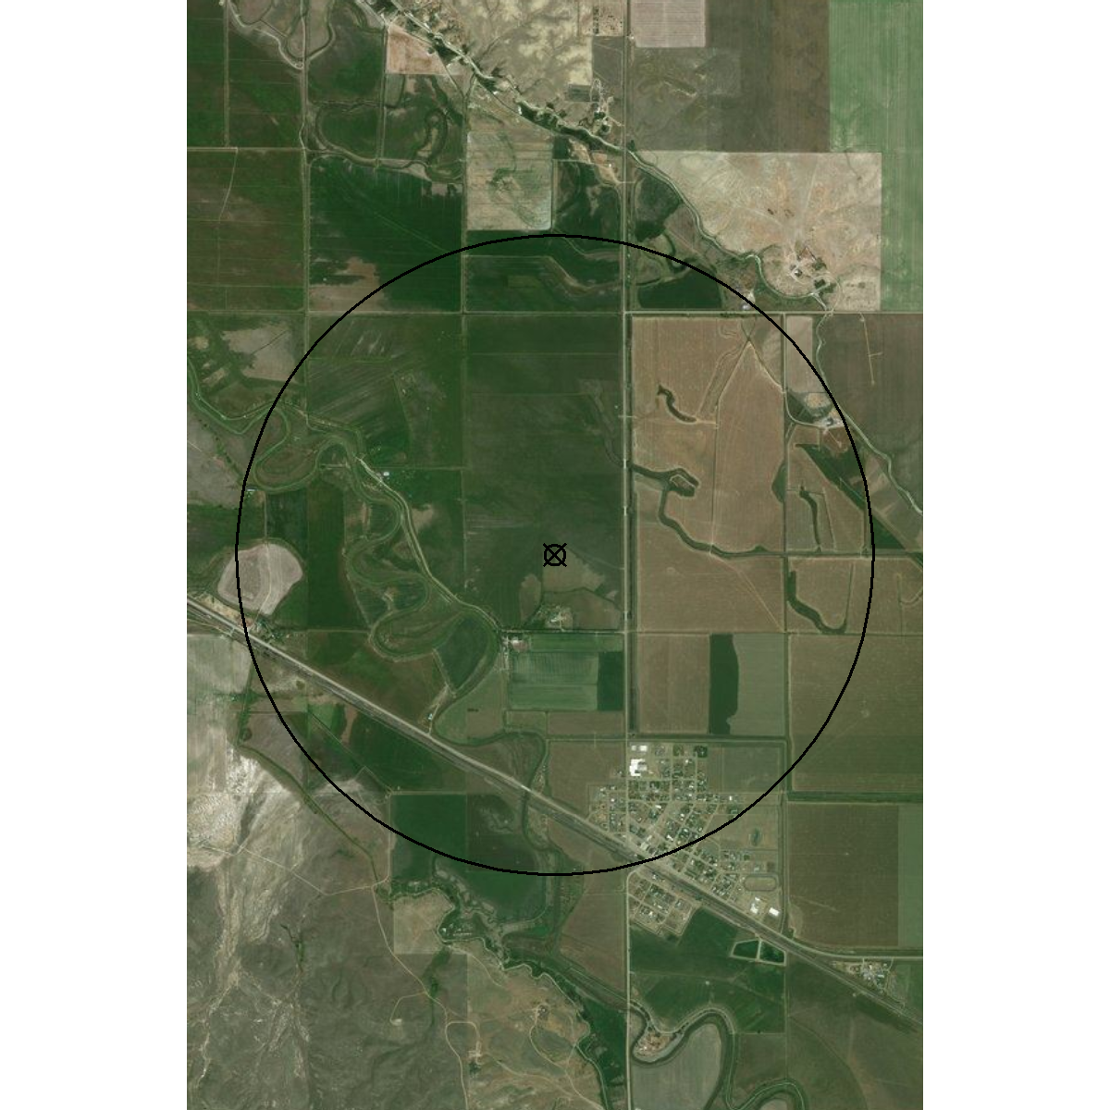
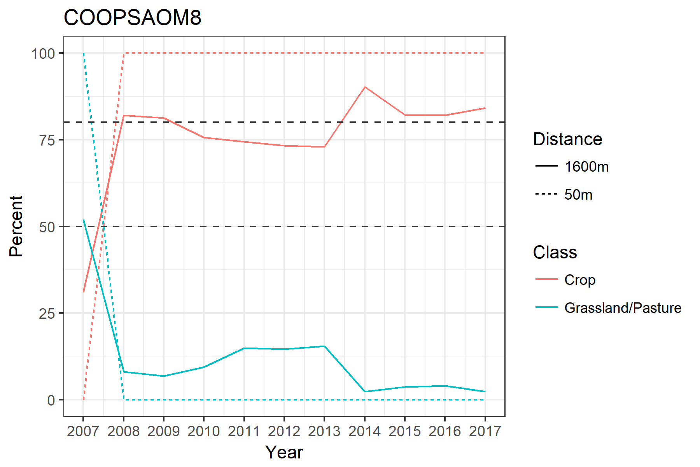
MesoWest Sites
COOPSAOM8 –

Slide 15
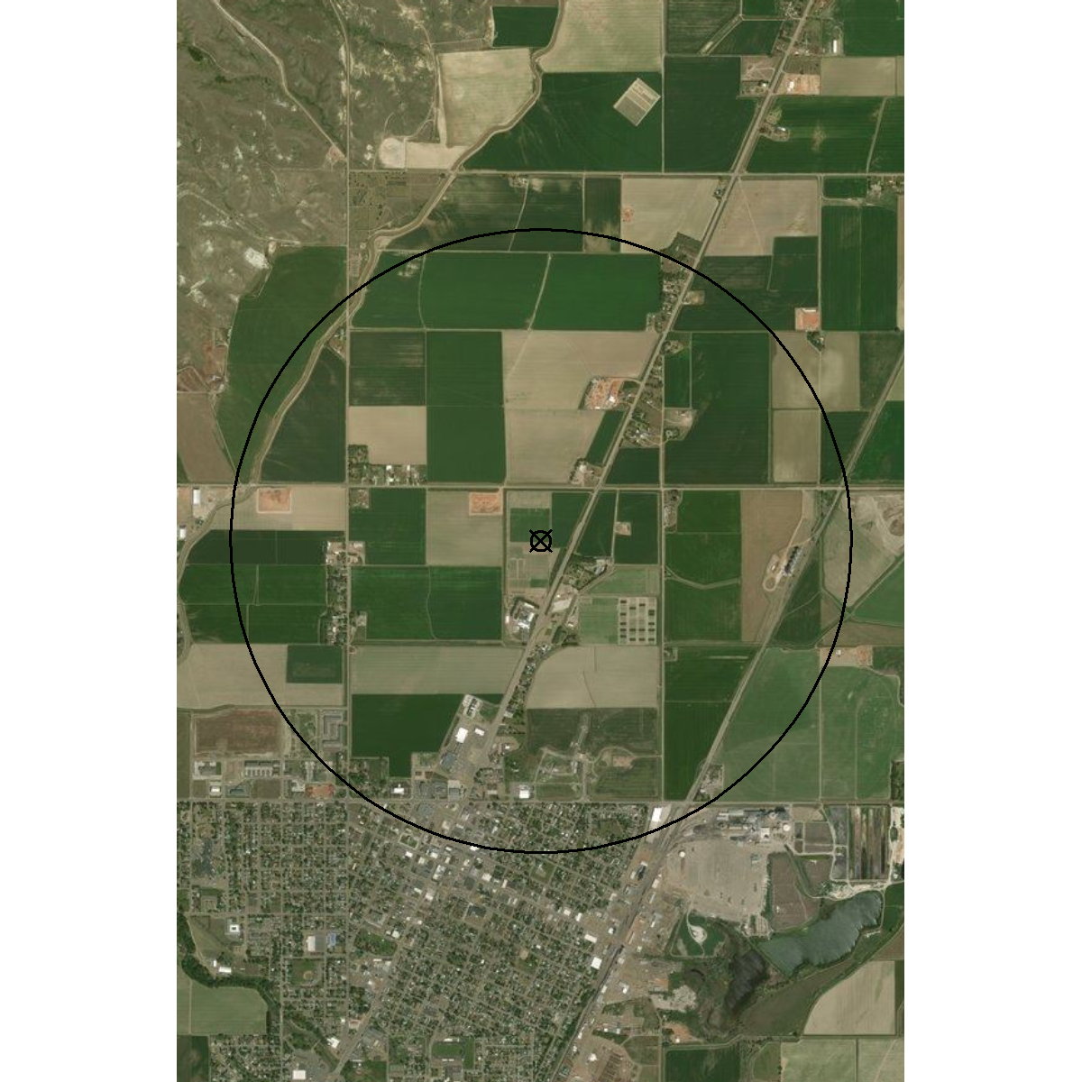
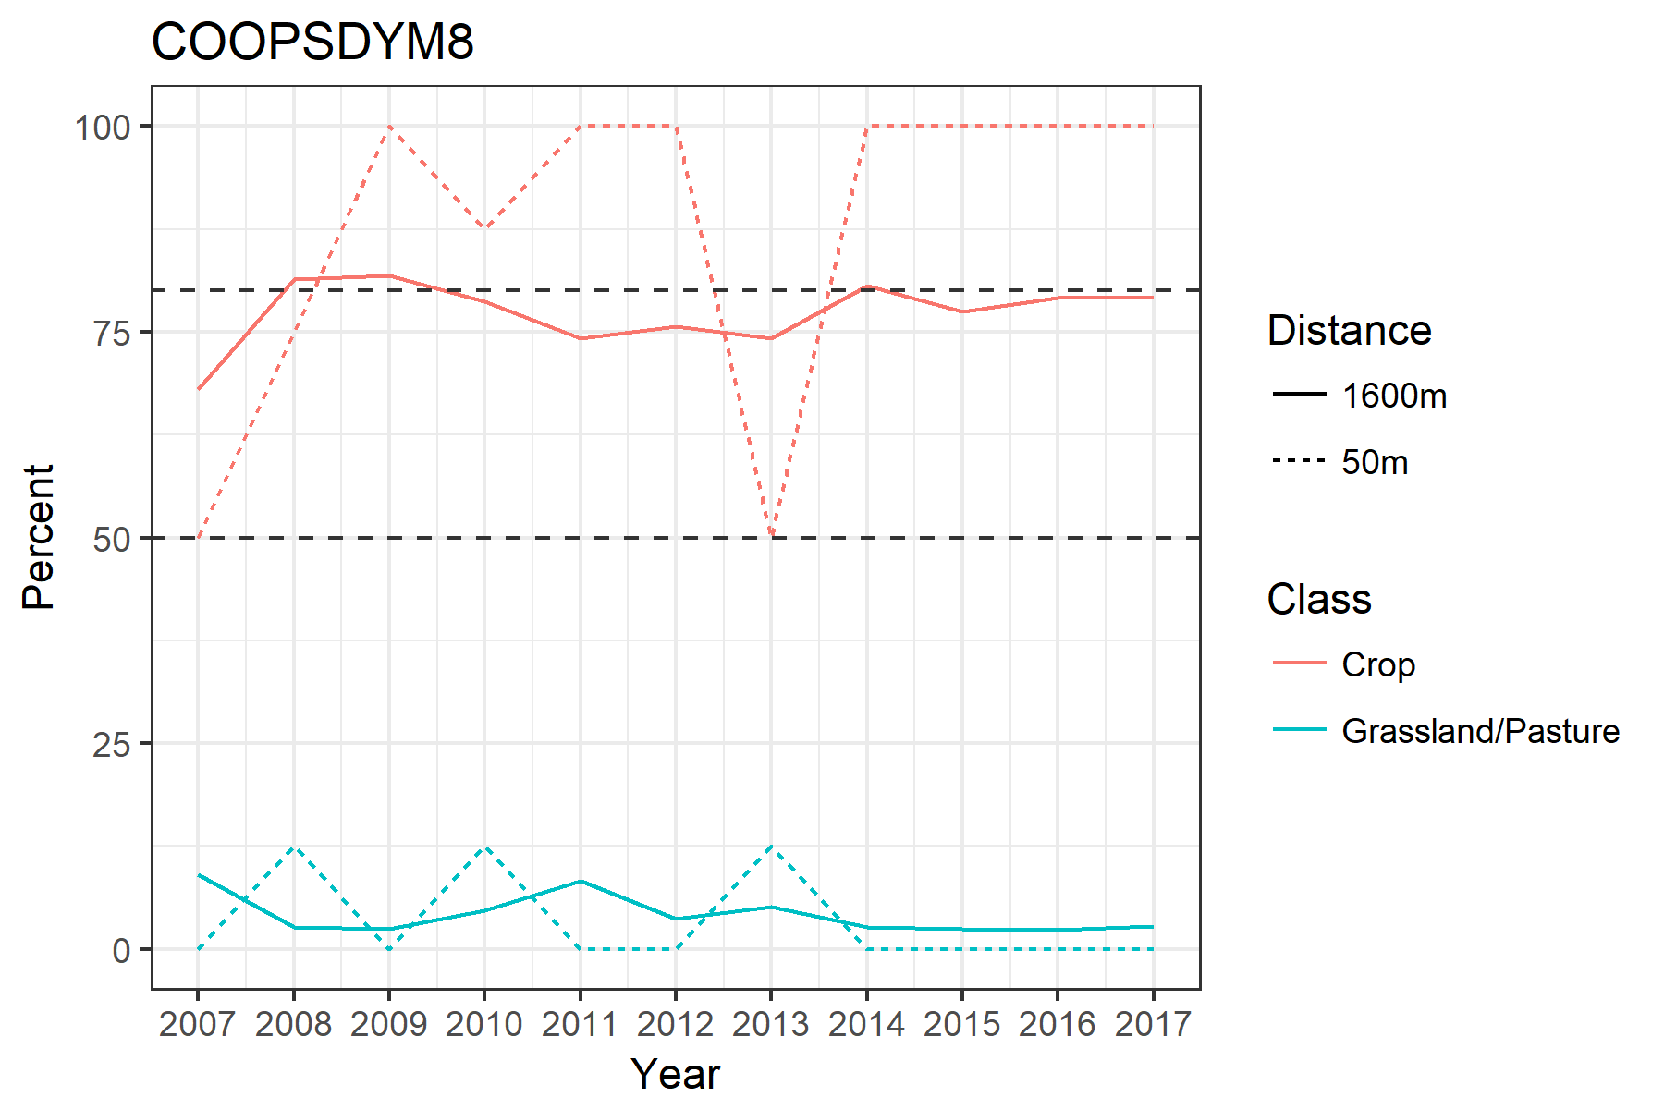
MesoWest Sites
COOPSDYM8 –

Slide 16
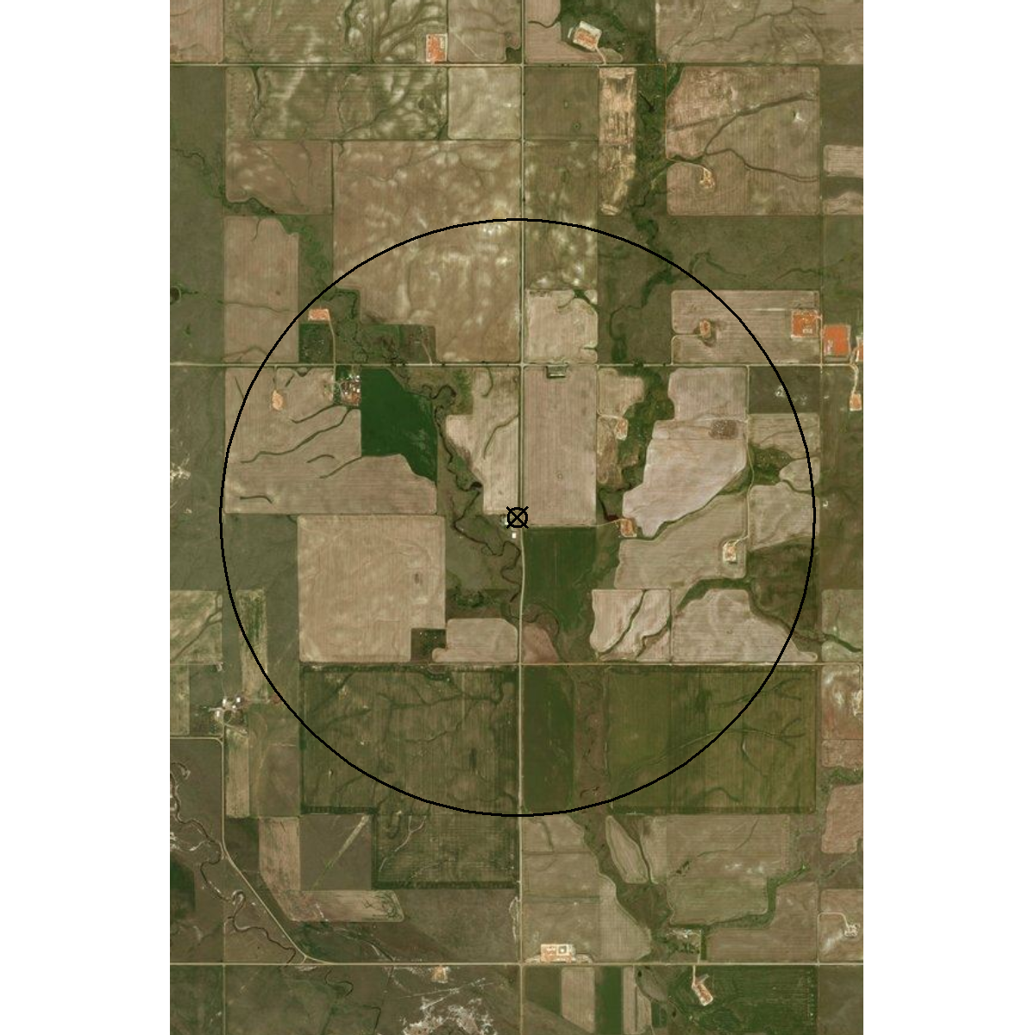
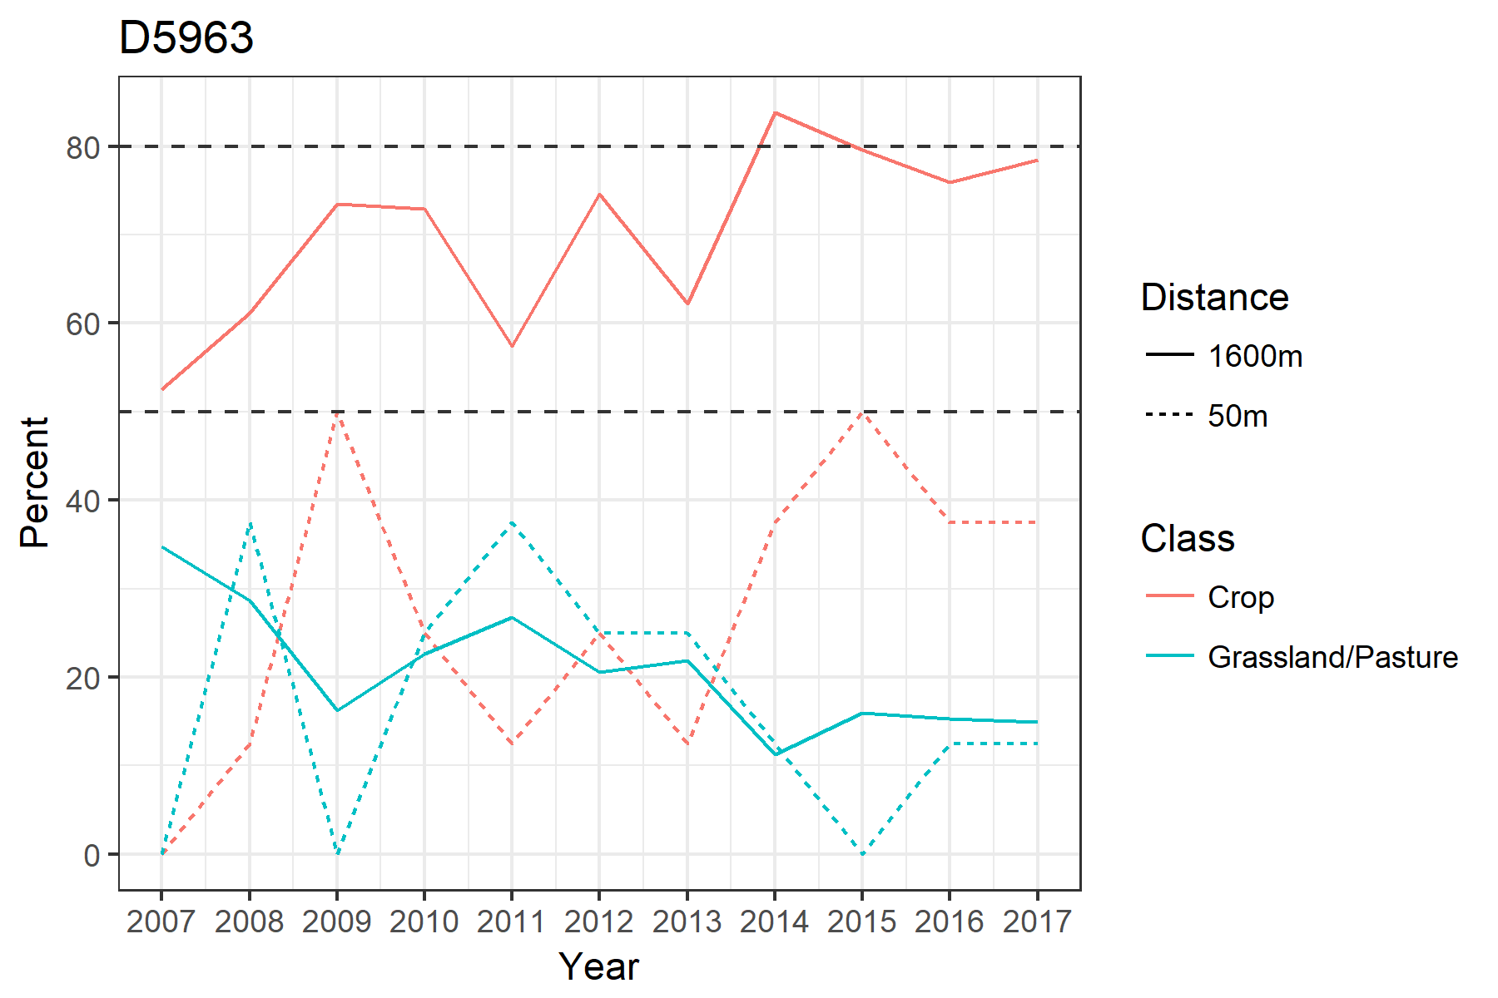
MesoWest Sites
D5963 –

Slide 17
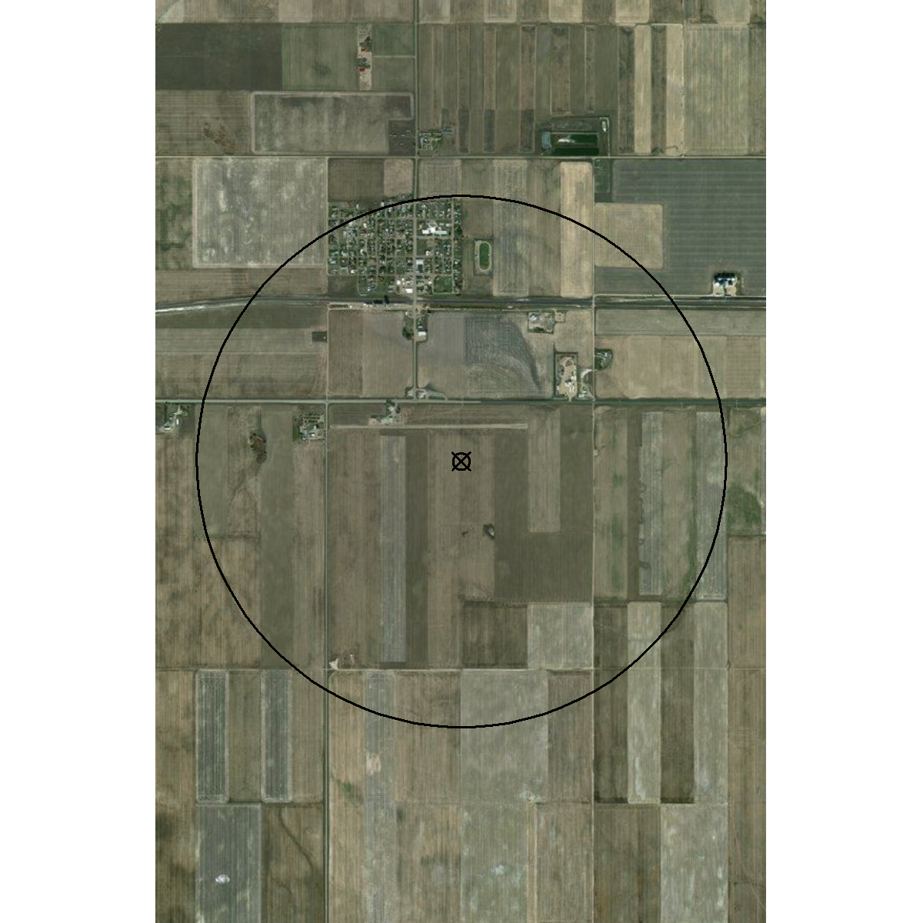
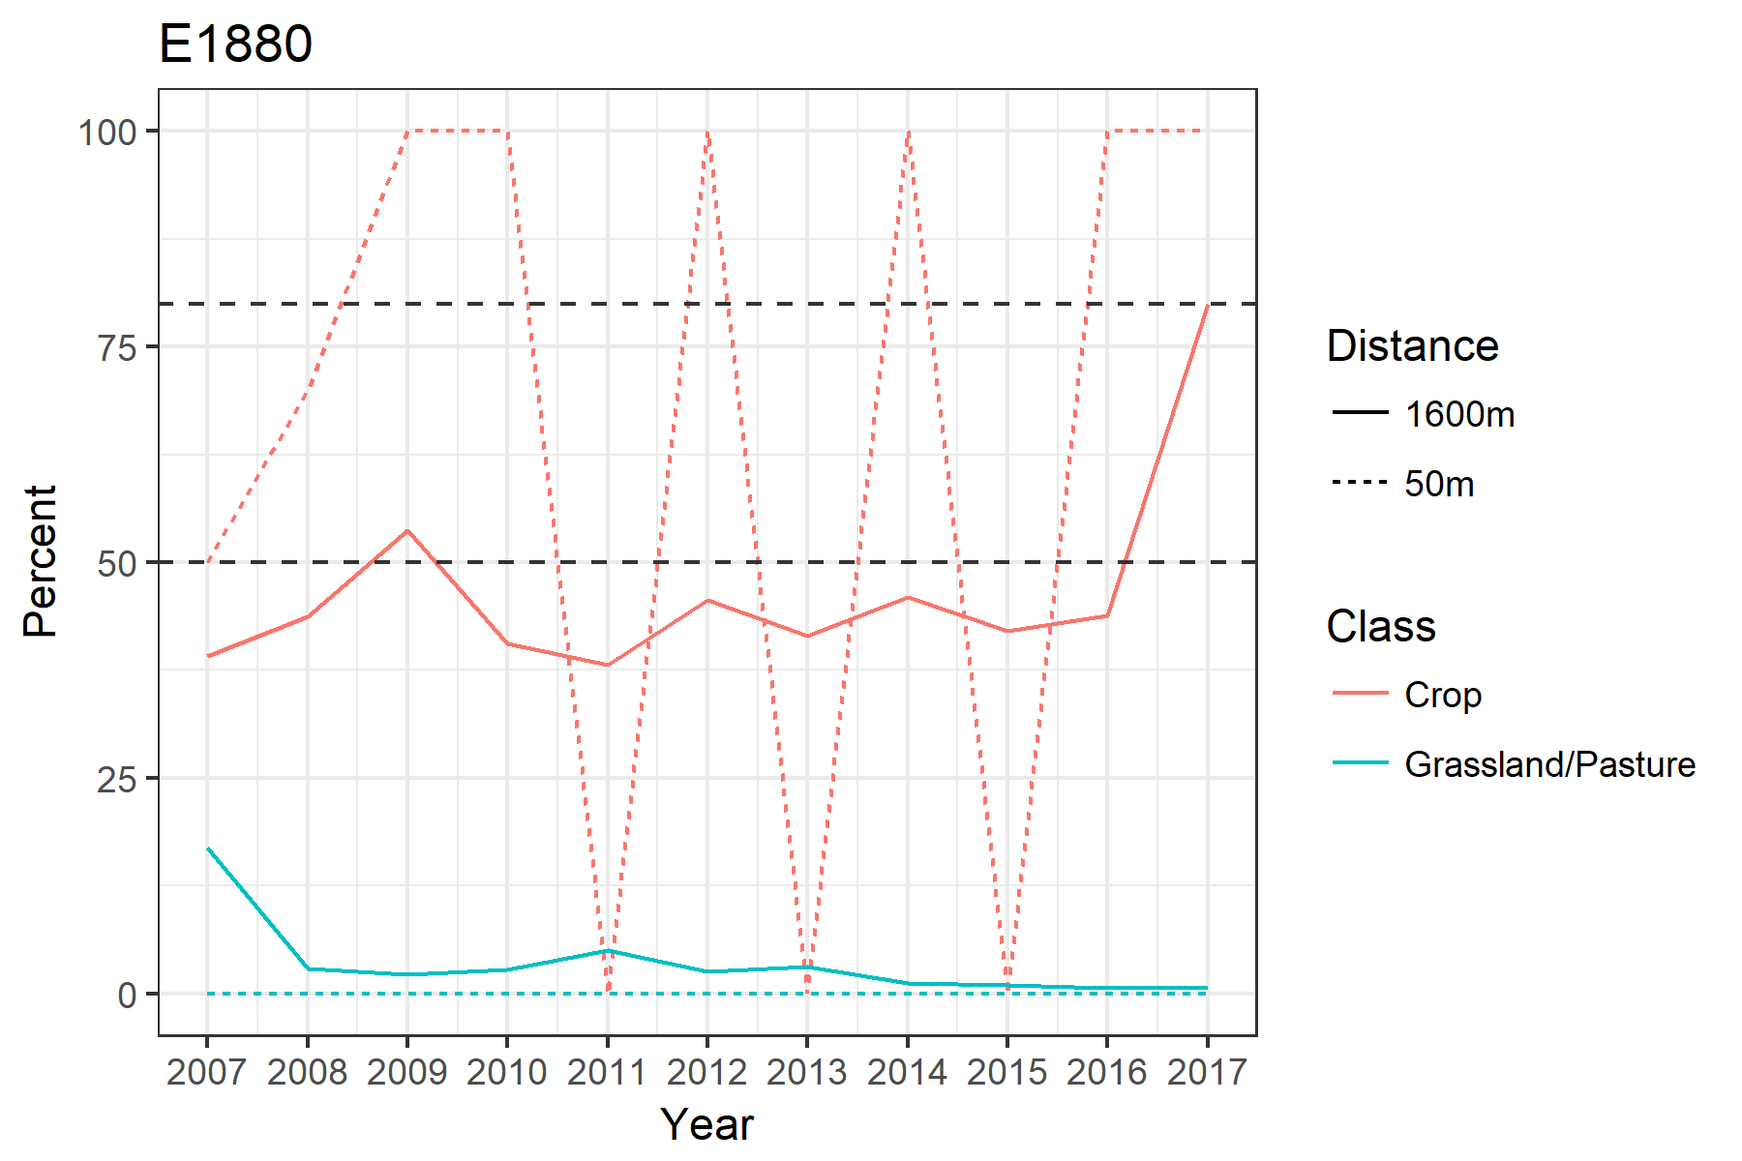
MesoWest Sites
E1880 –

Slide 18
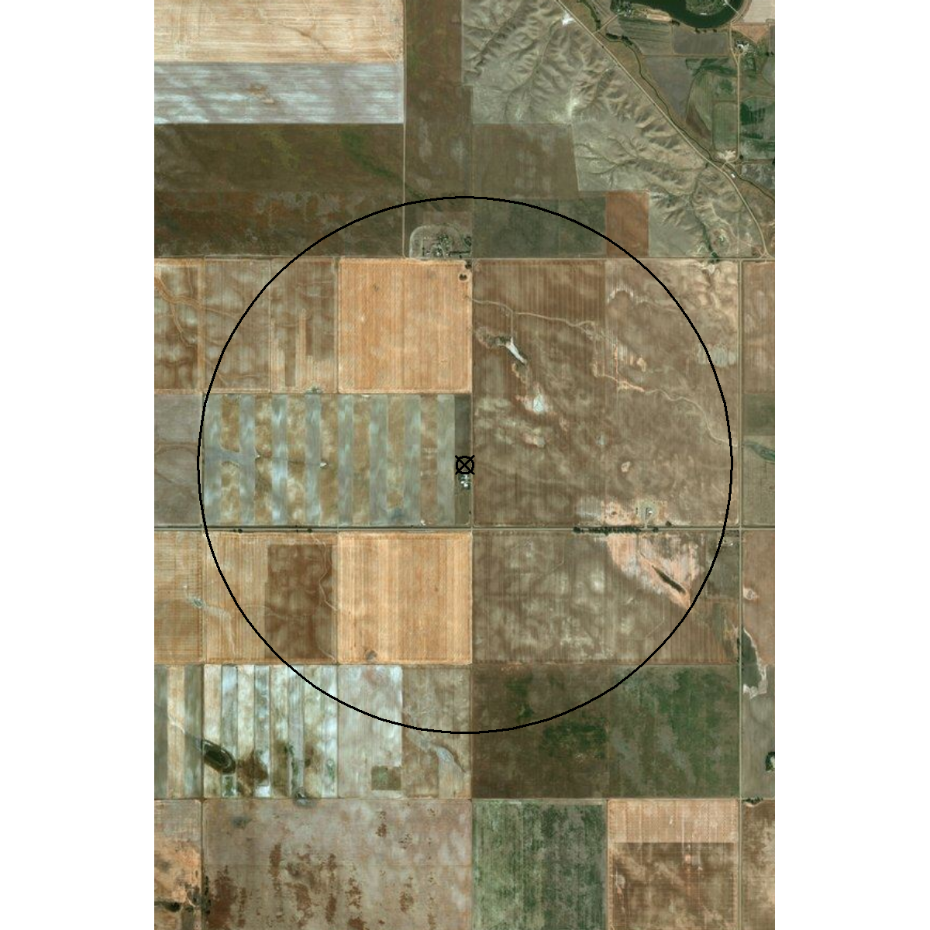
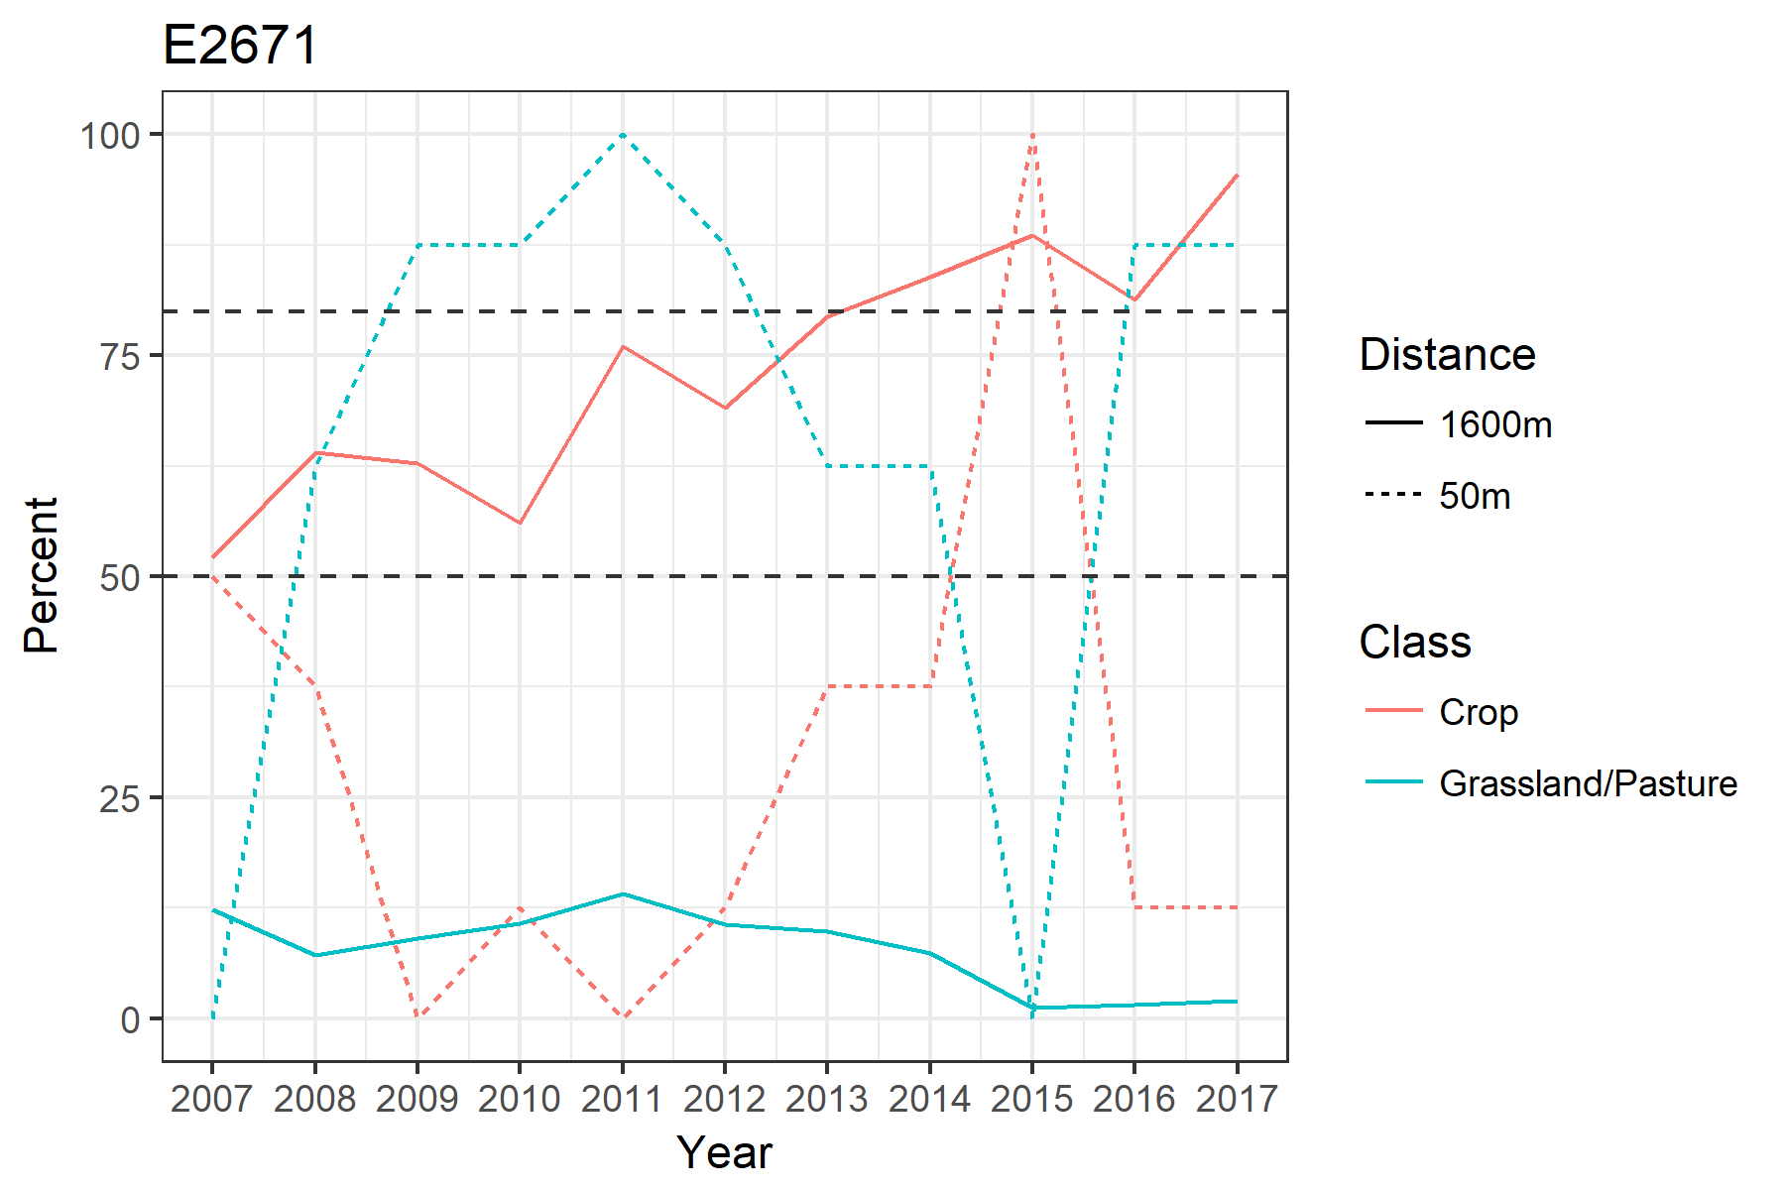
MesoWest Sites
E2671 –

Slide 19
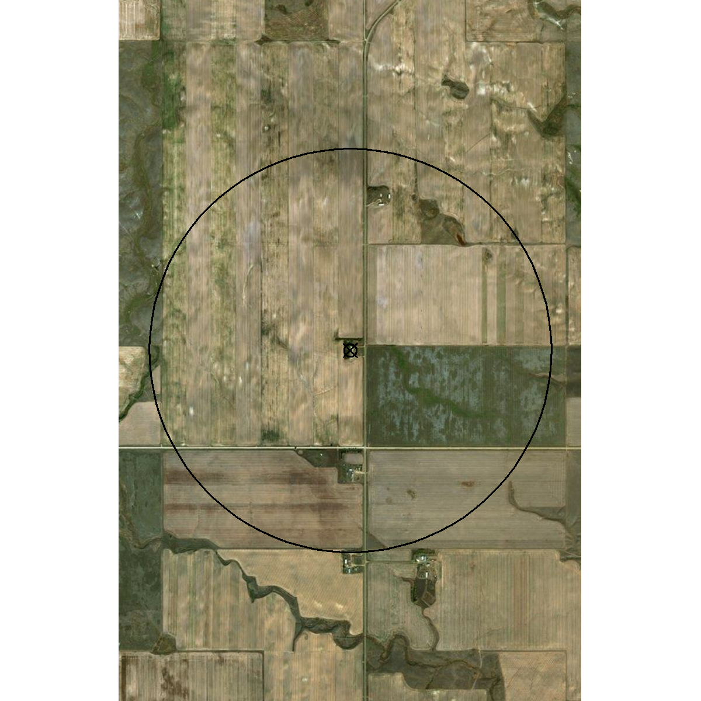
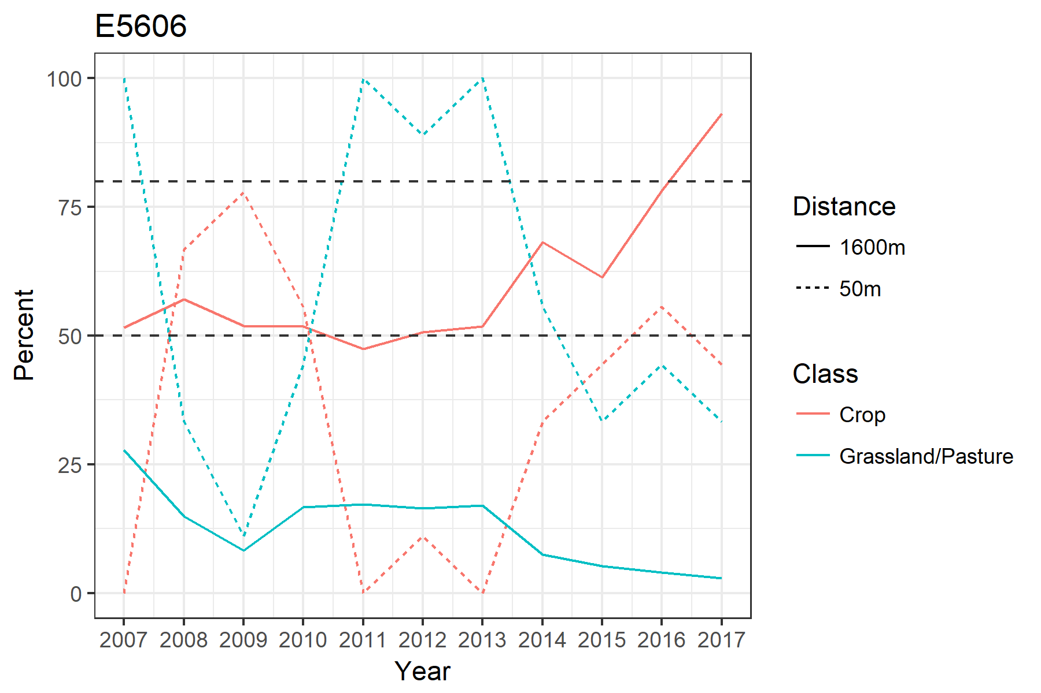
MesoWest Sites
E5606 –

Slide 20
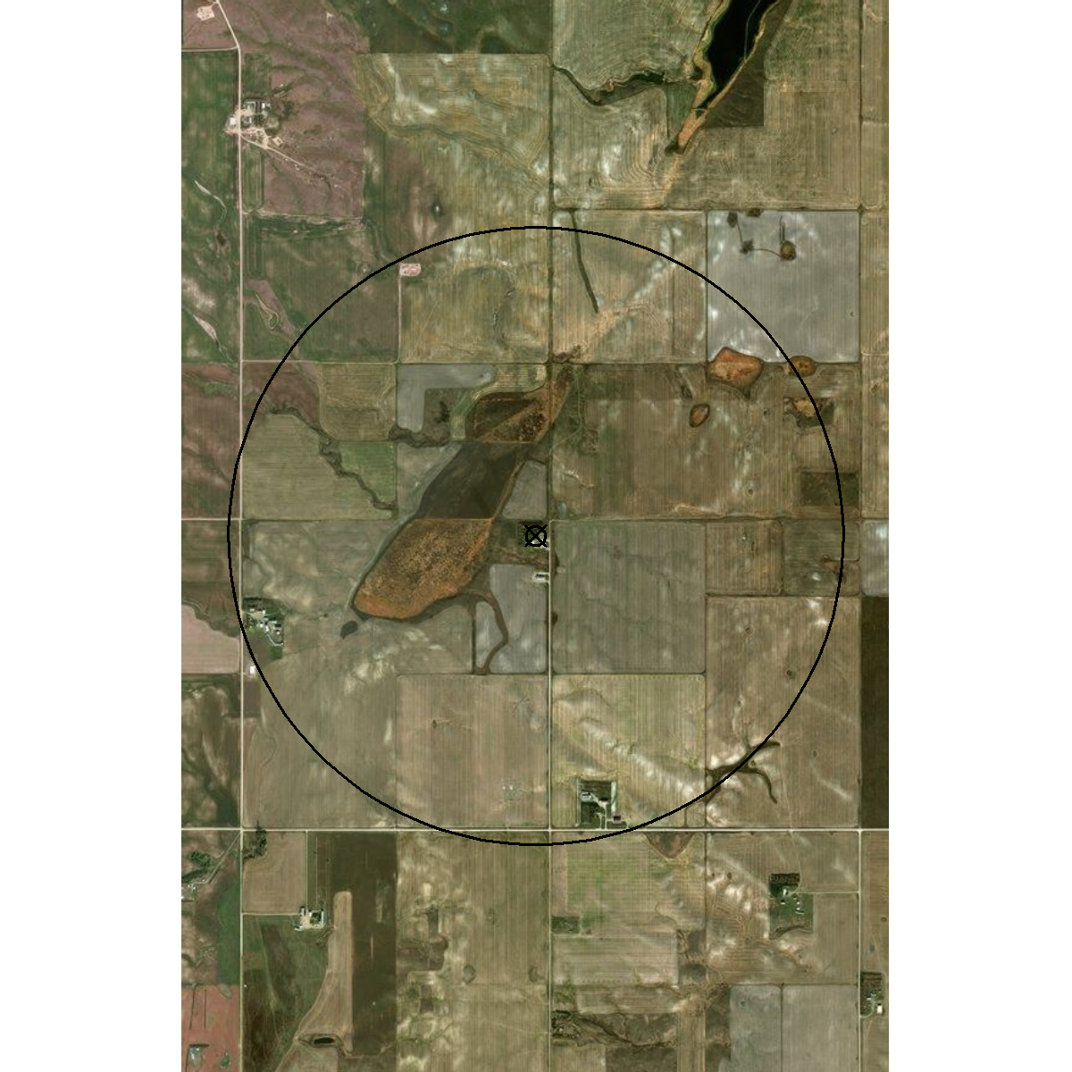
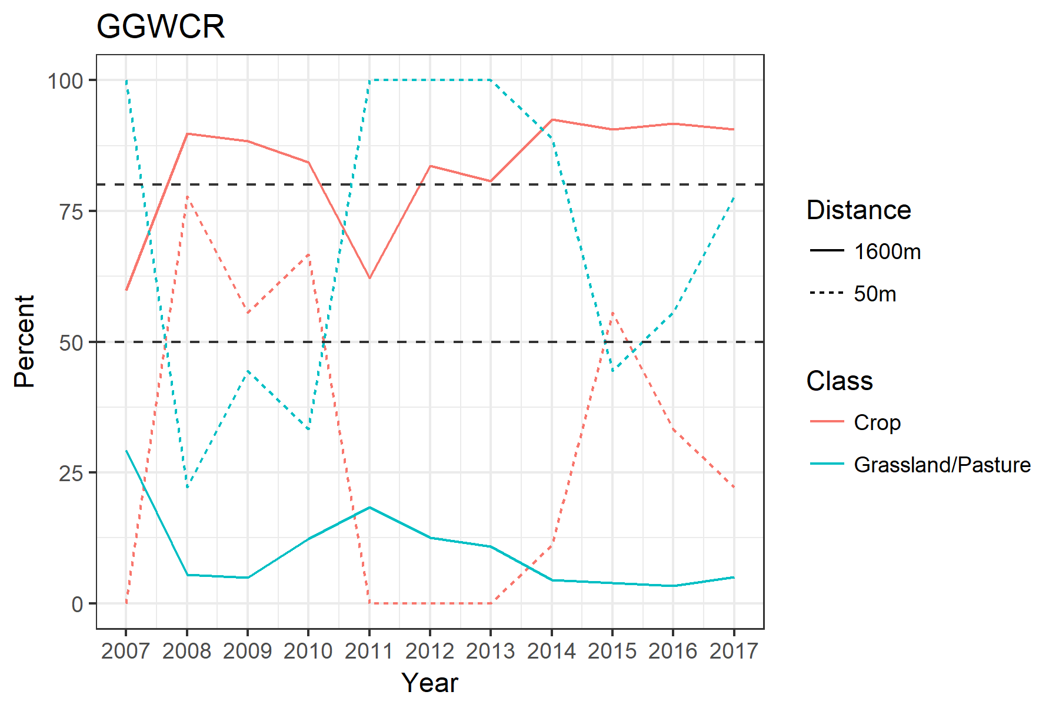
MesoWest Sites
GGWCR –

Slide 21
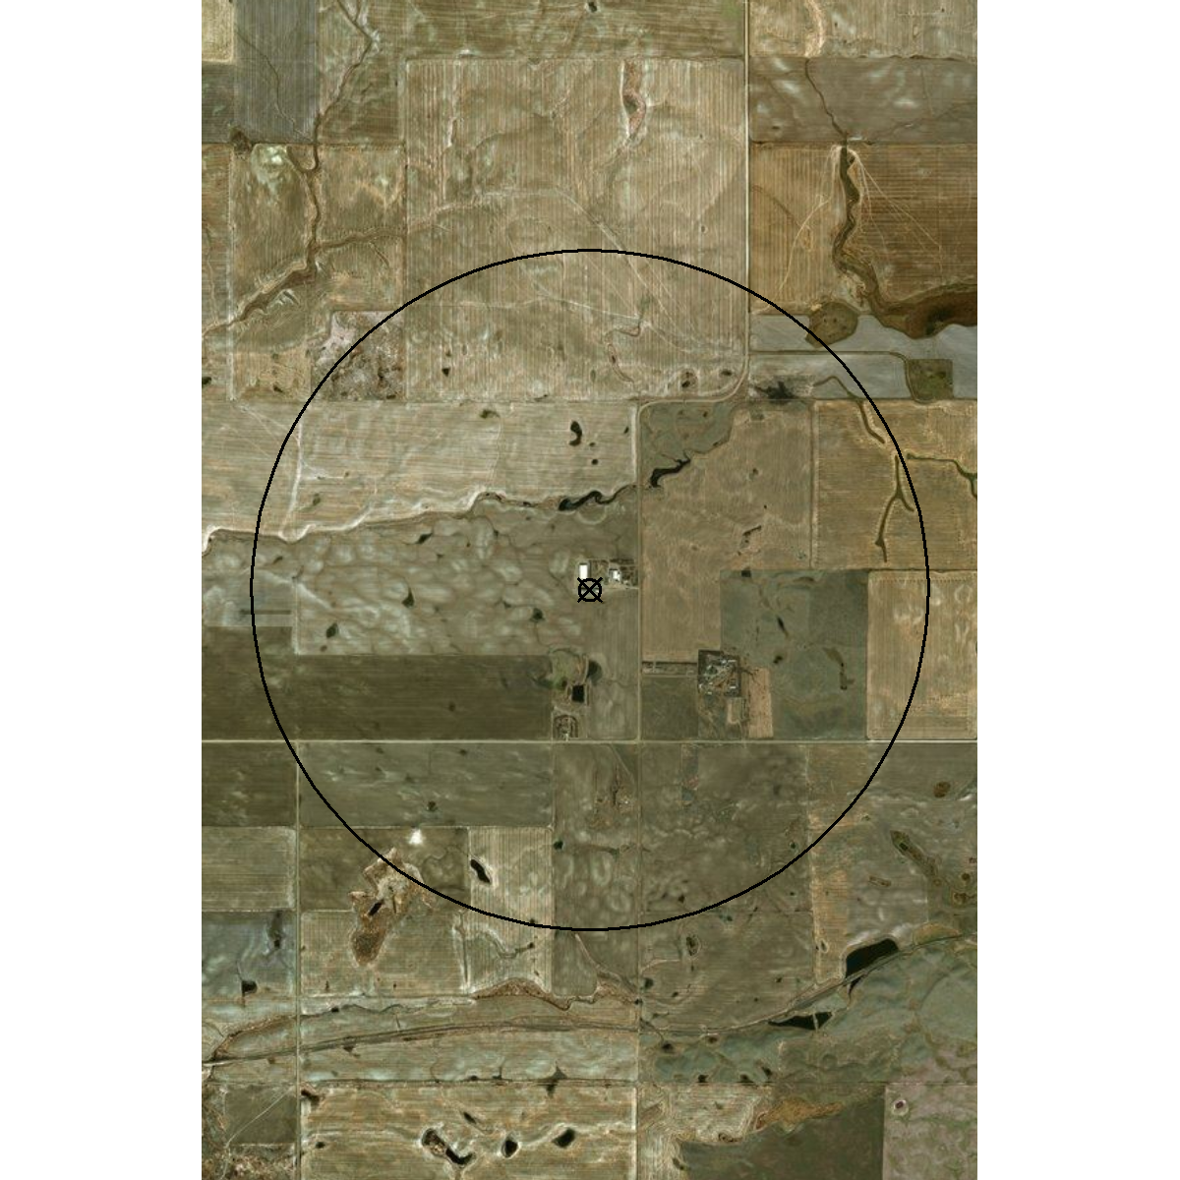
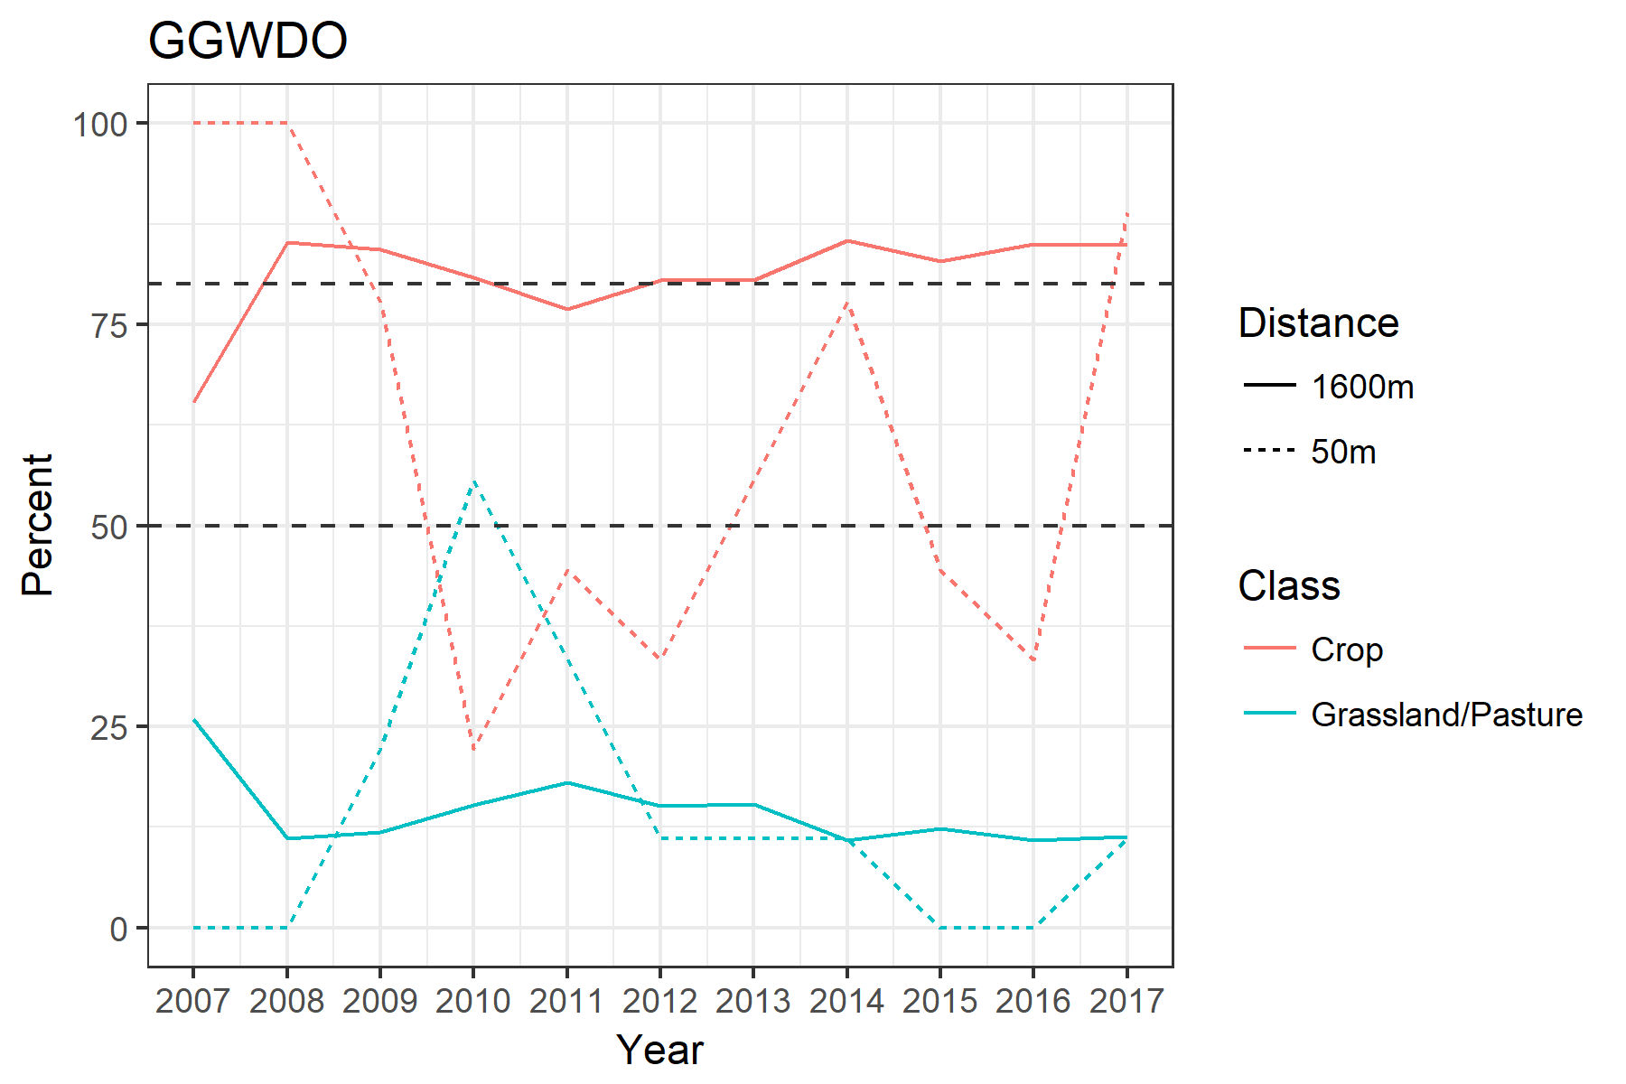
MesoWest Sites
GGWDO –

Slide 22
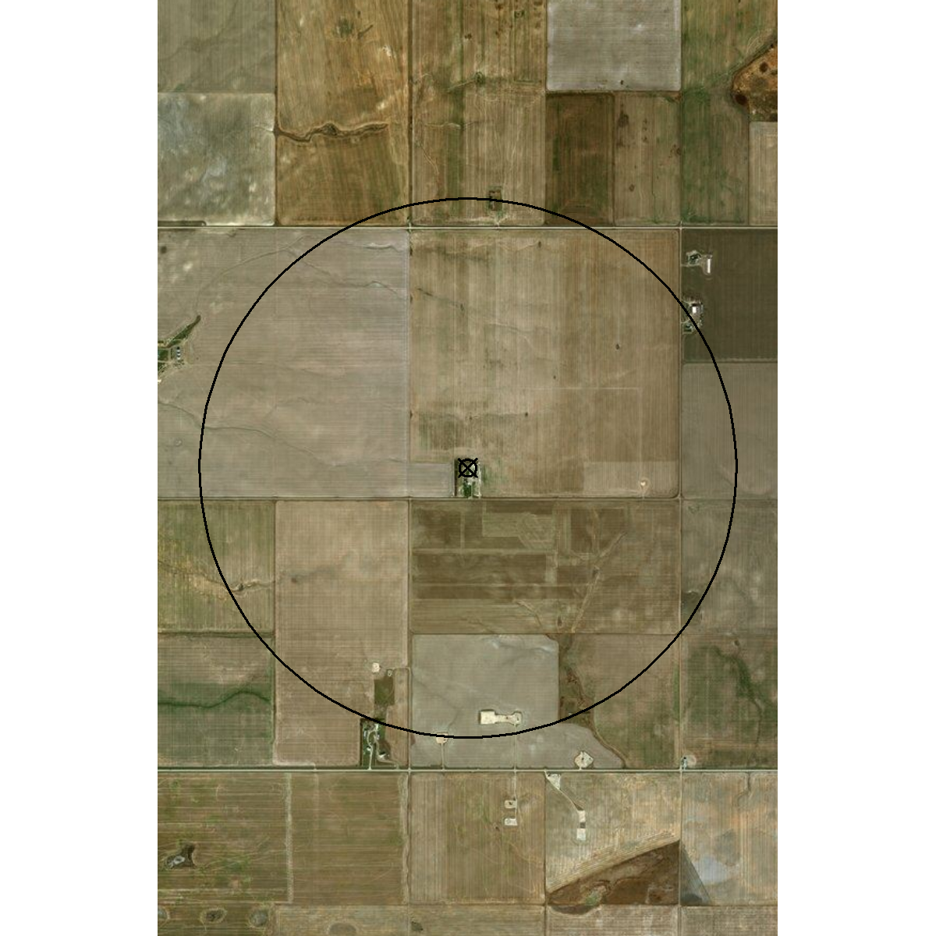
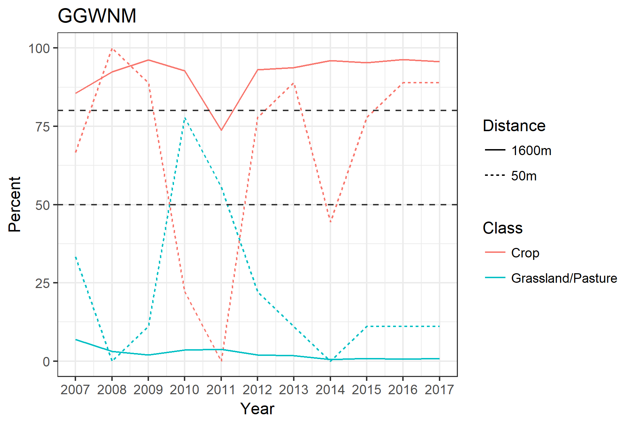
MesoWest Sites
GGWNM –

Slide 23
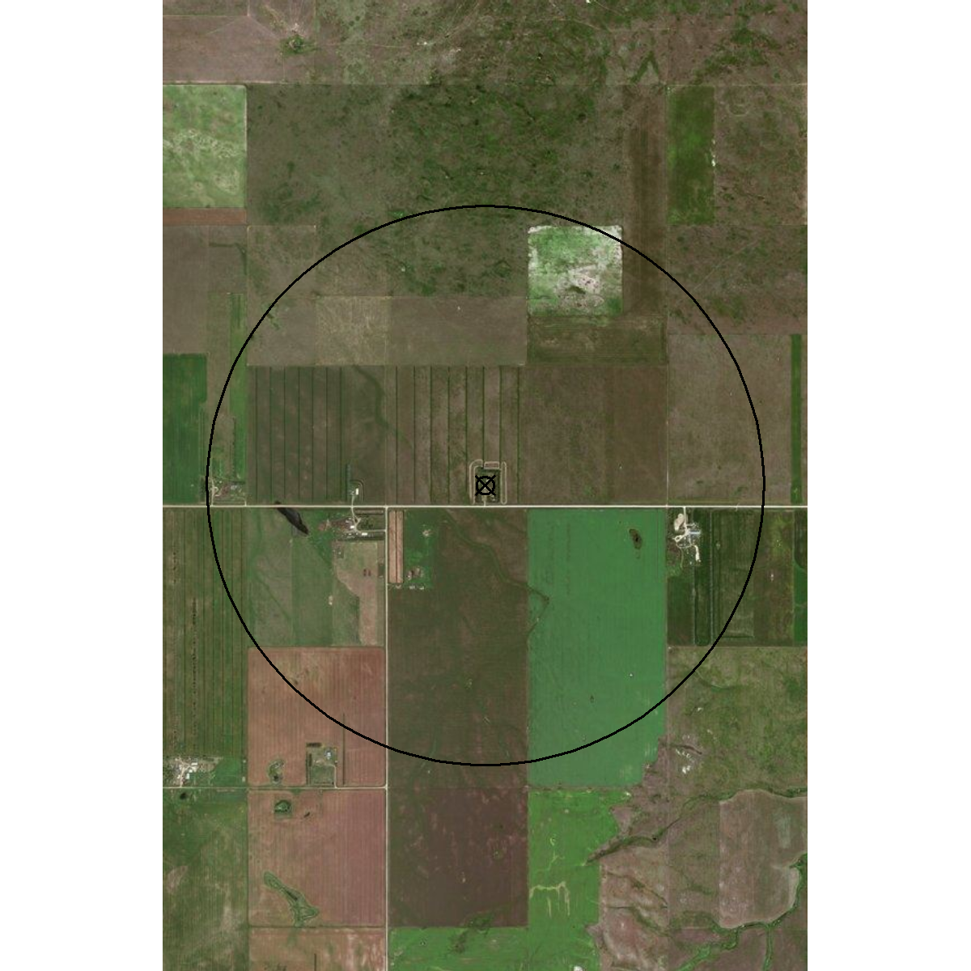
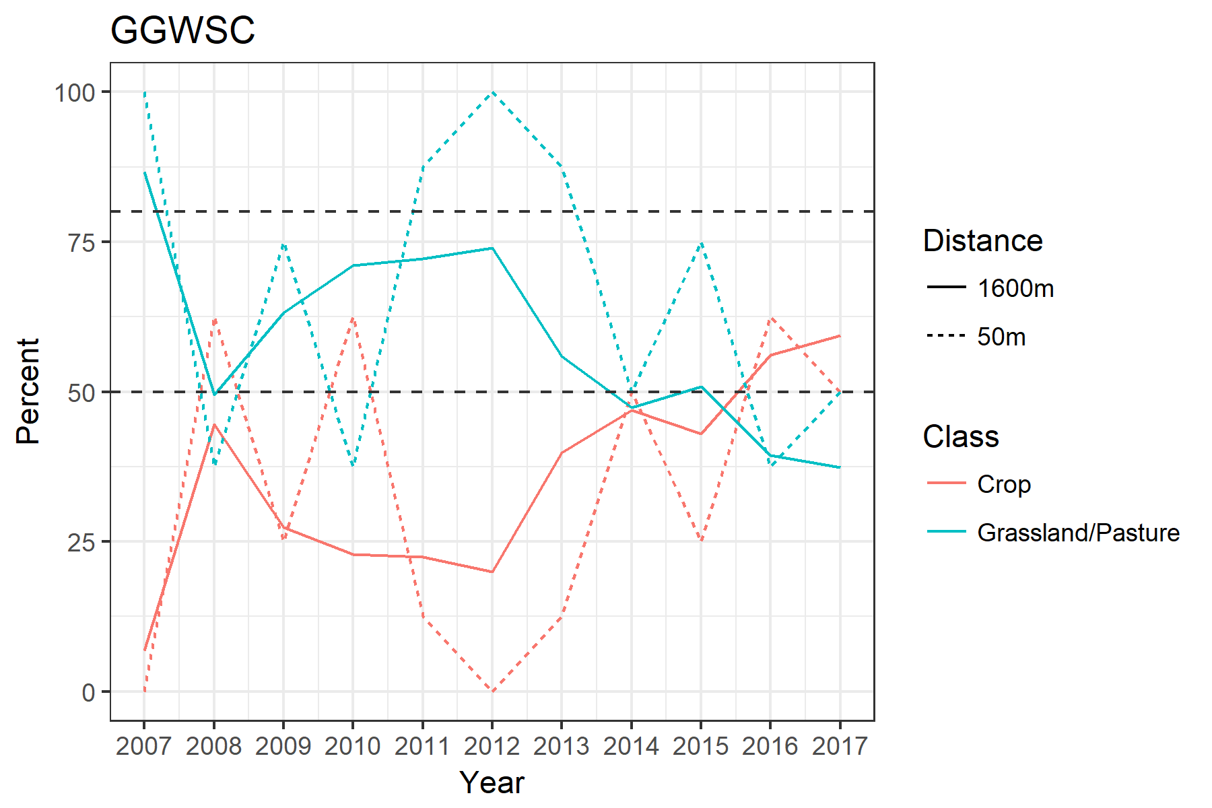
MesoWest Sites
GGWSC –

Slide 24
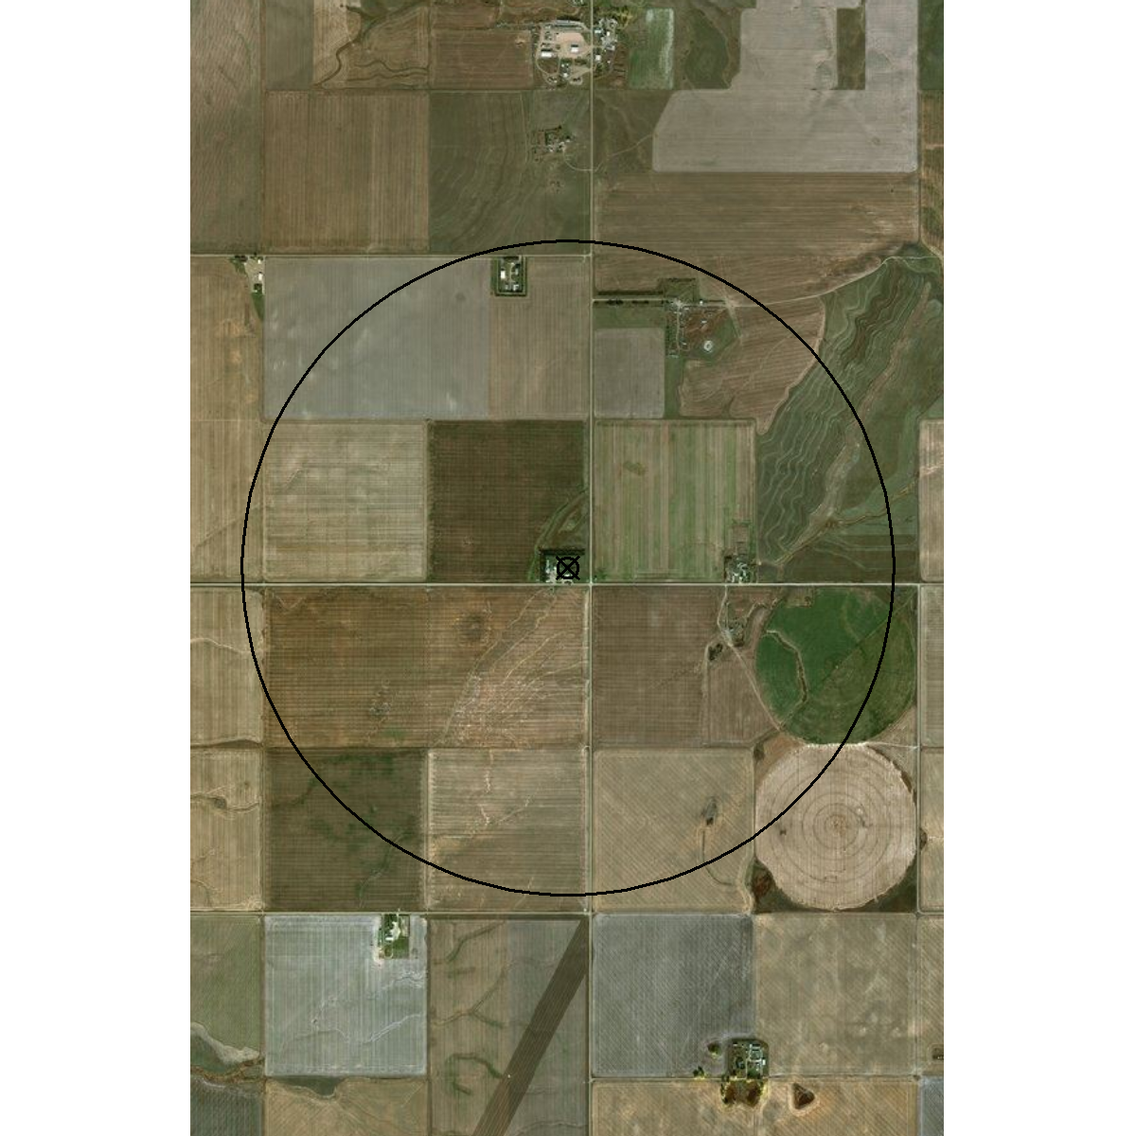
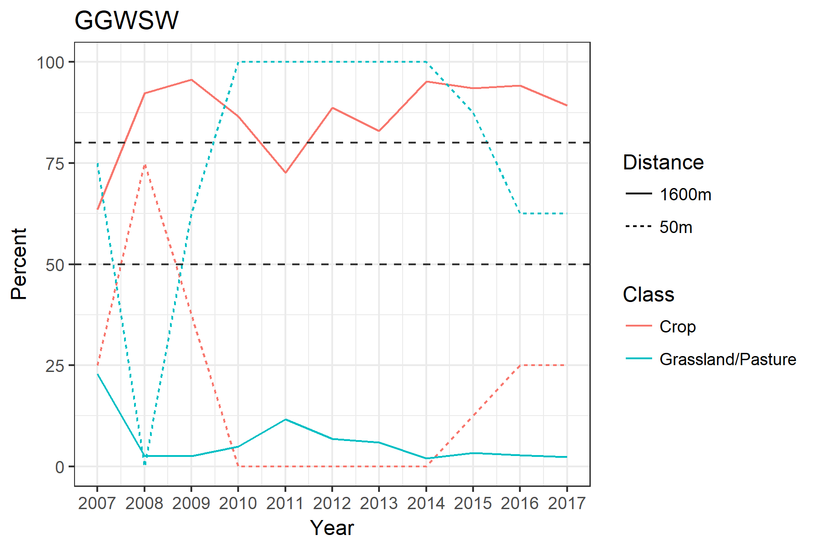
MesoWest Sites
GGWSW –

Slide 25
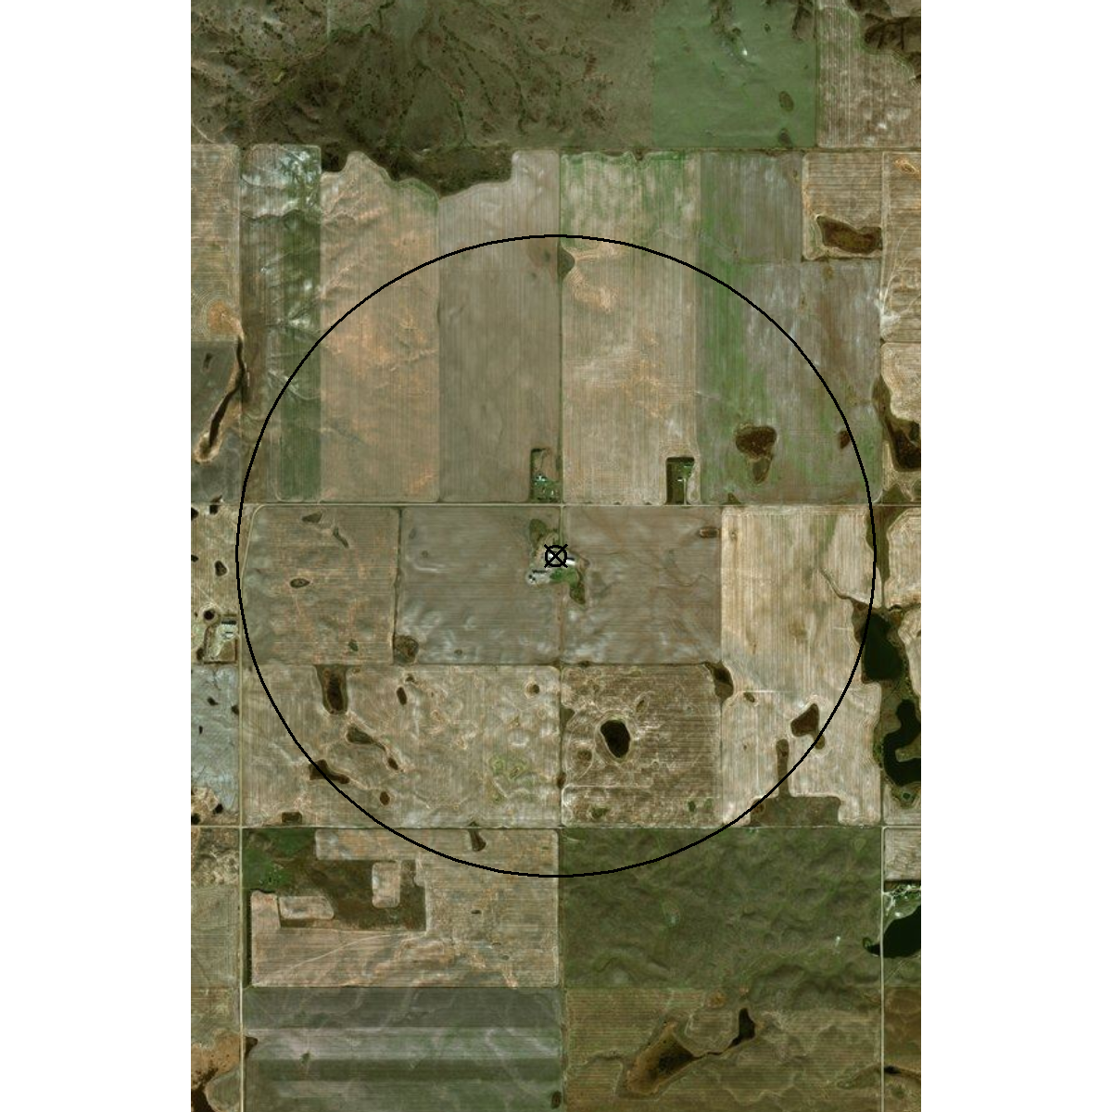
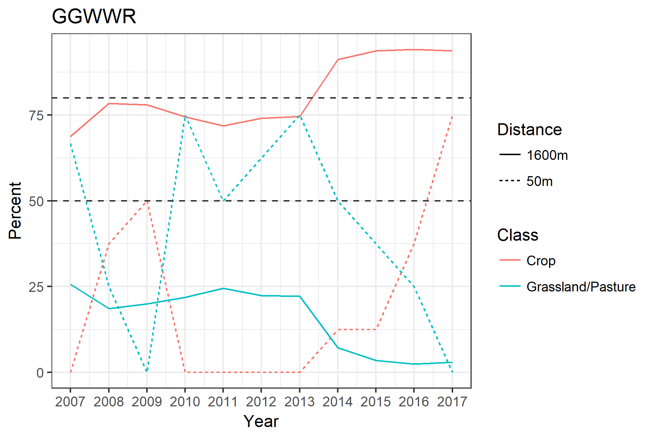
MesoWest Sites
GGWWR –

Slide 26

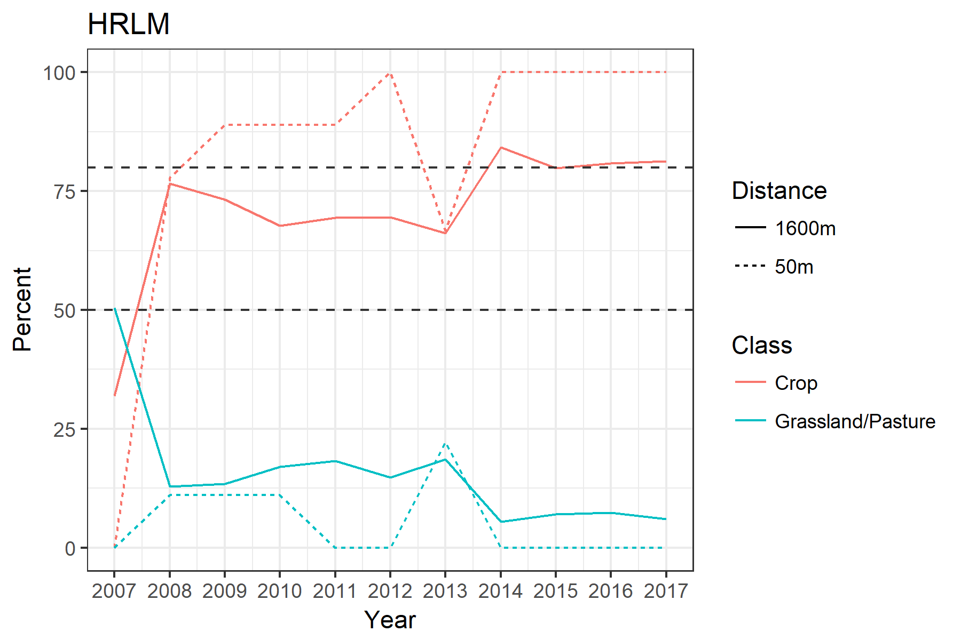
MesoWest Sites
HRLM –

Slide 27
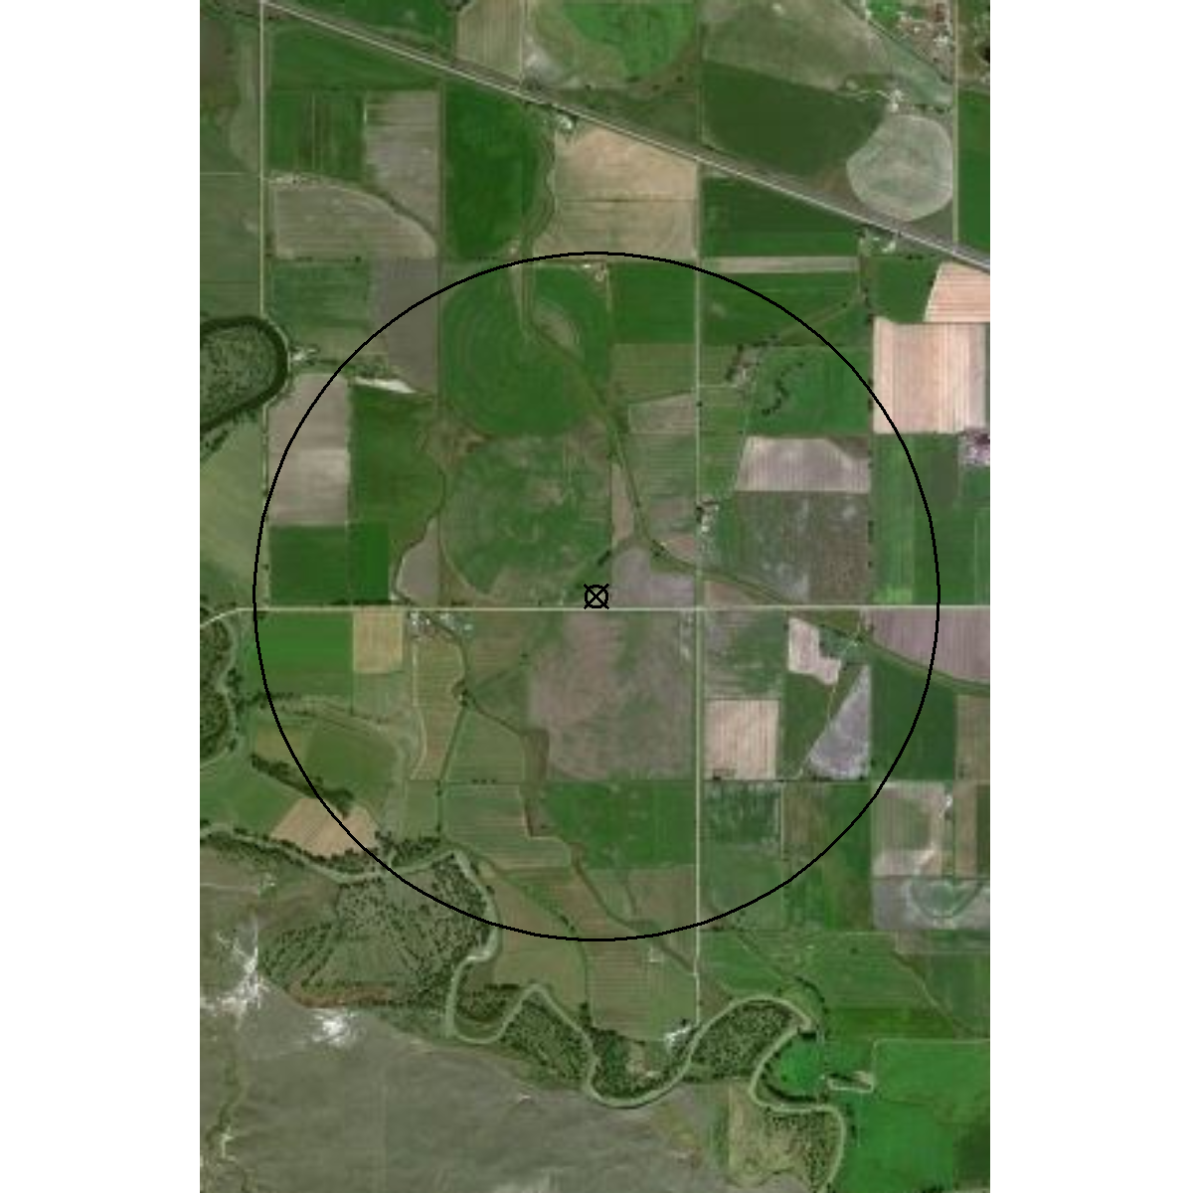
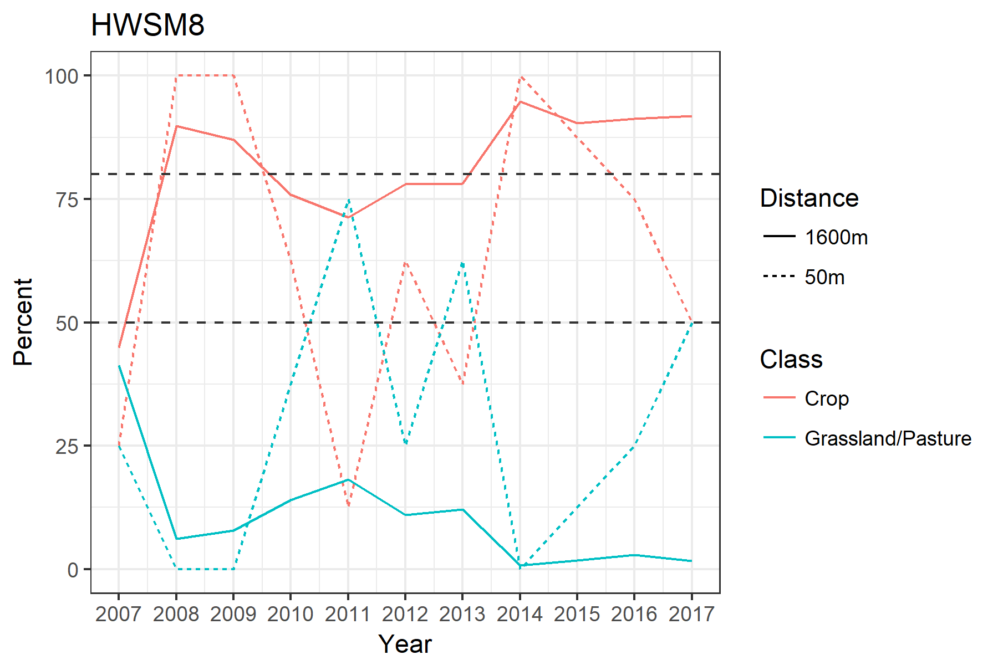
MesoWest Sites
HWSM8 –

Slide 28
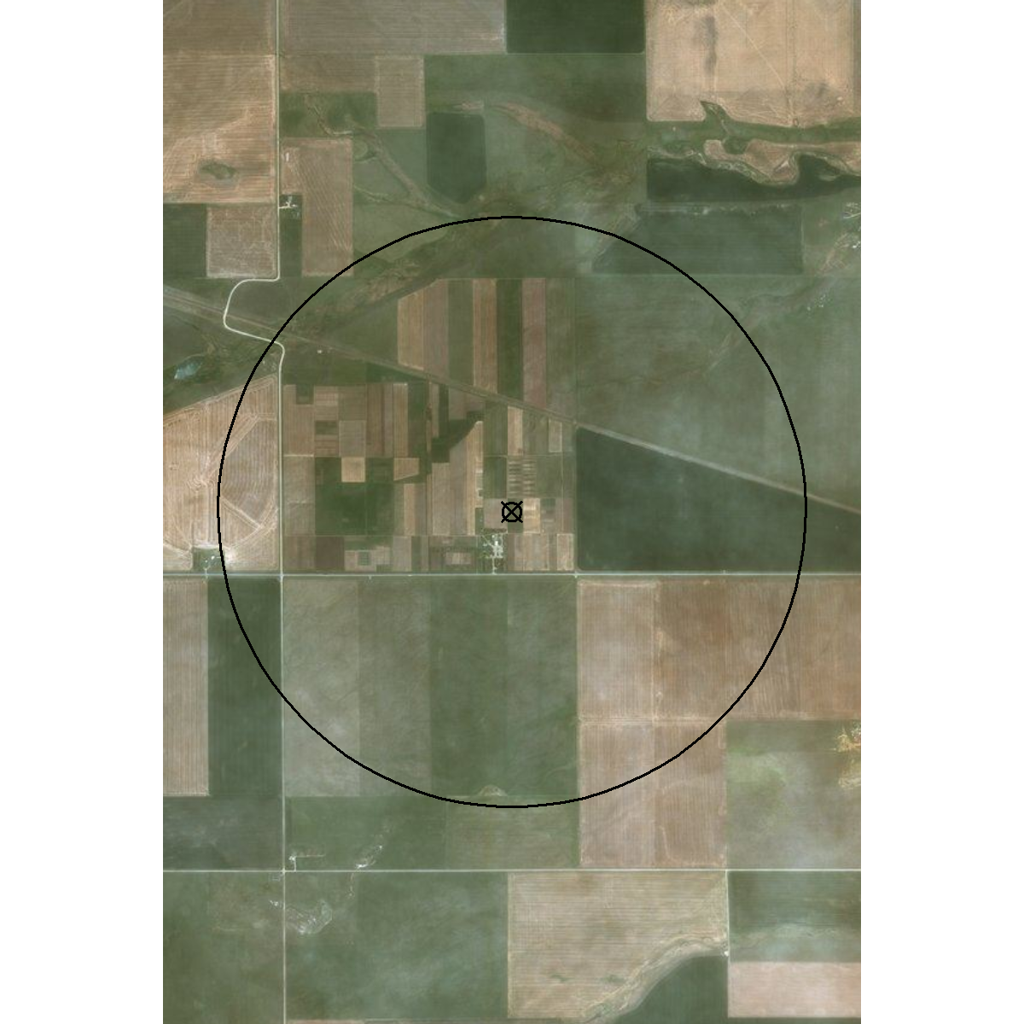
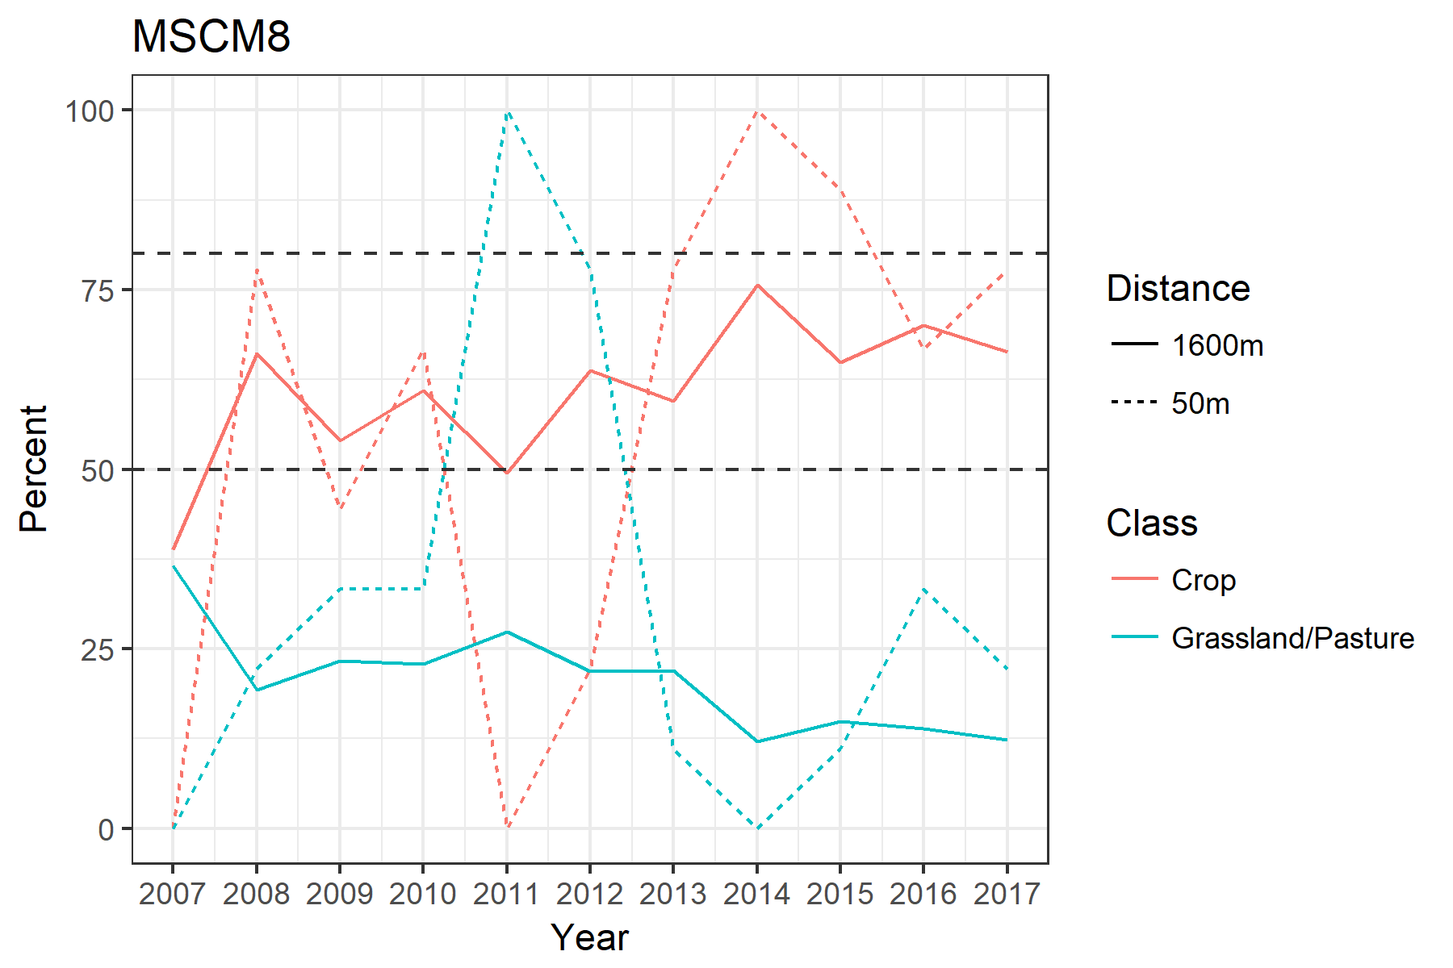
MesoWest Sites
MSCM8 –

Slide 29
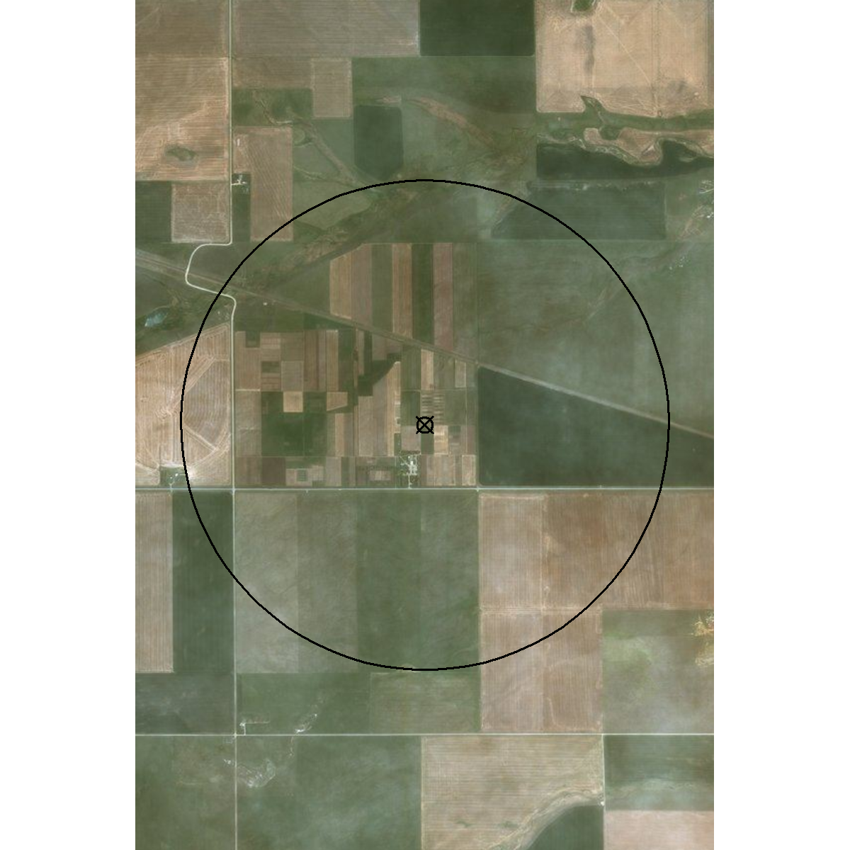
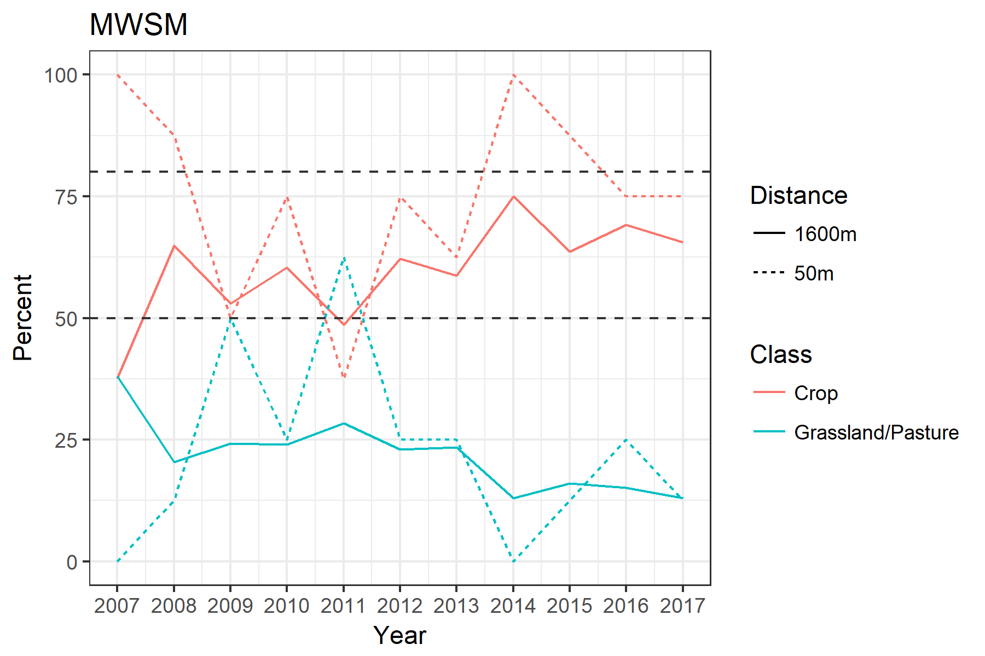
MesoWest Sites
MWSM –

Slide 30
MesoWest Sites (Possible)

Slide 31
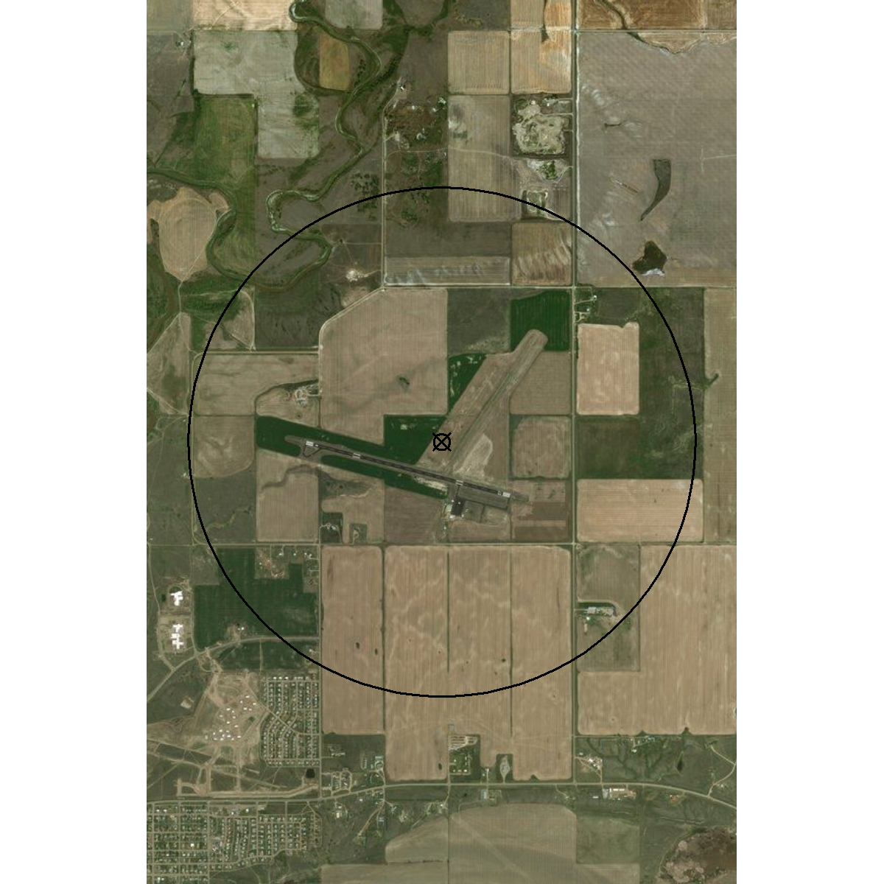
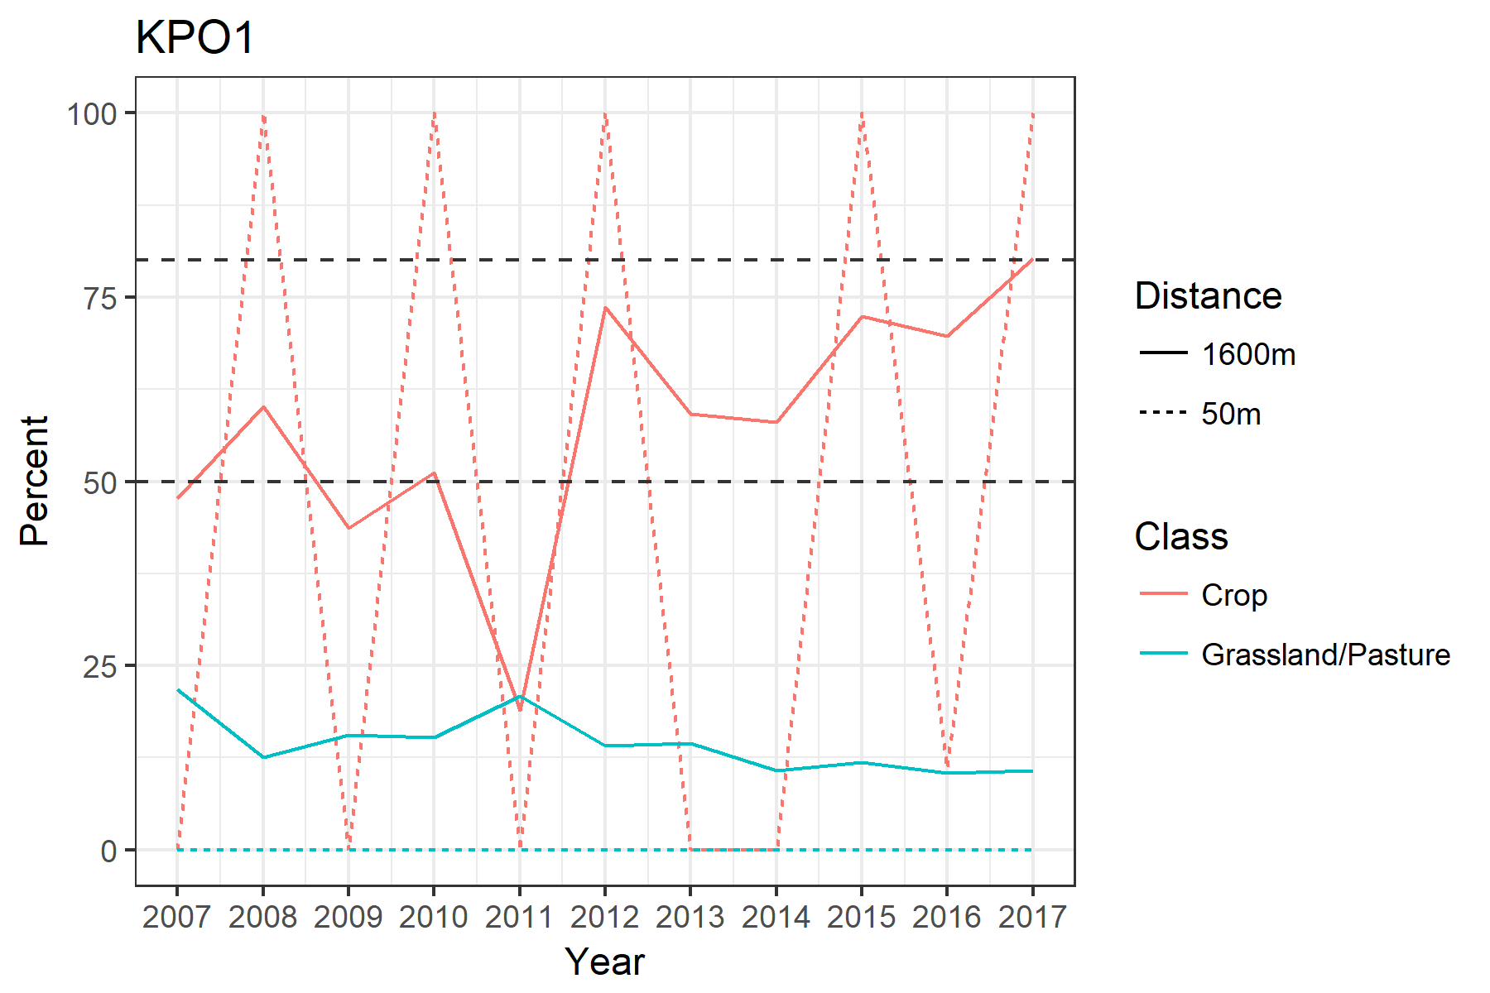
MesoWest Sites
KPO1 –

Slide 32
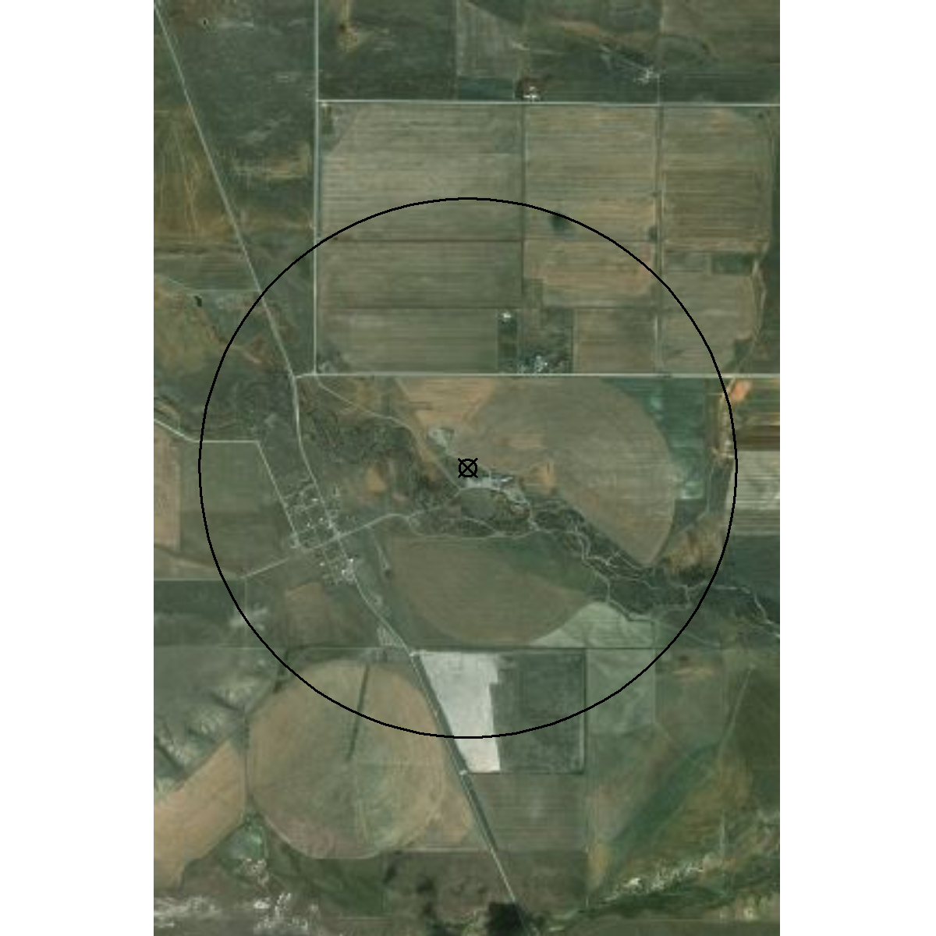

MesoWest Sites
PRKMT –

Slide 33


MesoWest Sites
D5890 –

Slide 34


MesoWest Sites
D0217 –

Slide 35


MesoWest Sites
COOPWBXM8 –

Slide 36


MesoWest Sites
COOPVALM8 –

